Slide 1
NOAA:
MAKING AN IMPACT
FROM THE SURFACE OF THE SUN TO THE BOTTOM OF THE SEA
Notes:
INTRO SLIDE:
I am going to tell you how NOAA learns about our world and makes an impact from the surface of the sun to the bottom of the ocean and how you could be part of NOAA’s exciting work.

Slide 2
What is NOAA? National Oceanic and Atmospheric Administration
A bureau of the U.S. Department of Commerce
Notes:
SLIDE 2 (NOAA):
The National Oceanic and Atmospheric Administration---NOAA--- is a United States federal government agency. NOAA explores our ocean, coasts, climate and weather right here on Earth. NOAA has satellites that take pictures from space, planes that can fly into hurricanes, and underwater robots that explore the deepest part of the ocean.

Slide 3
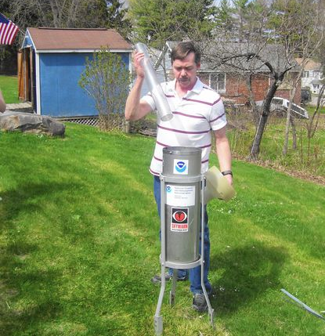
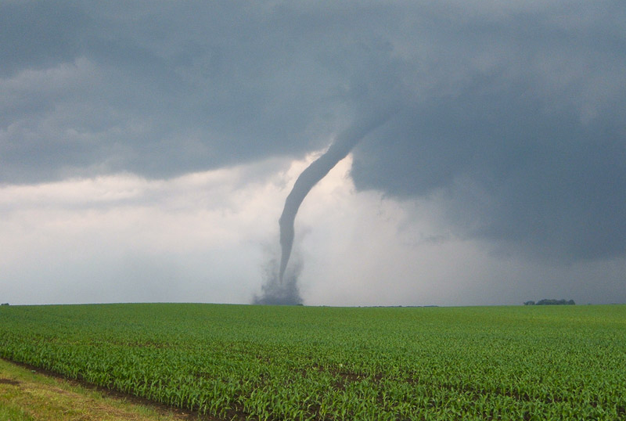
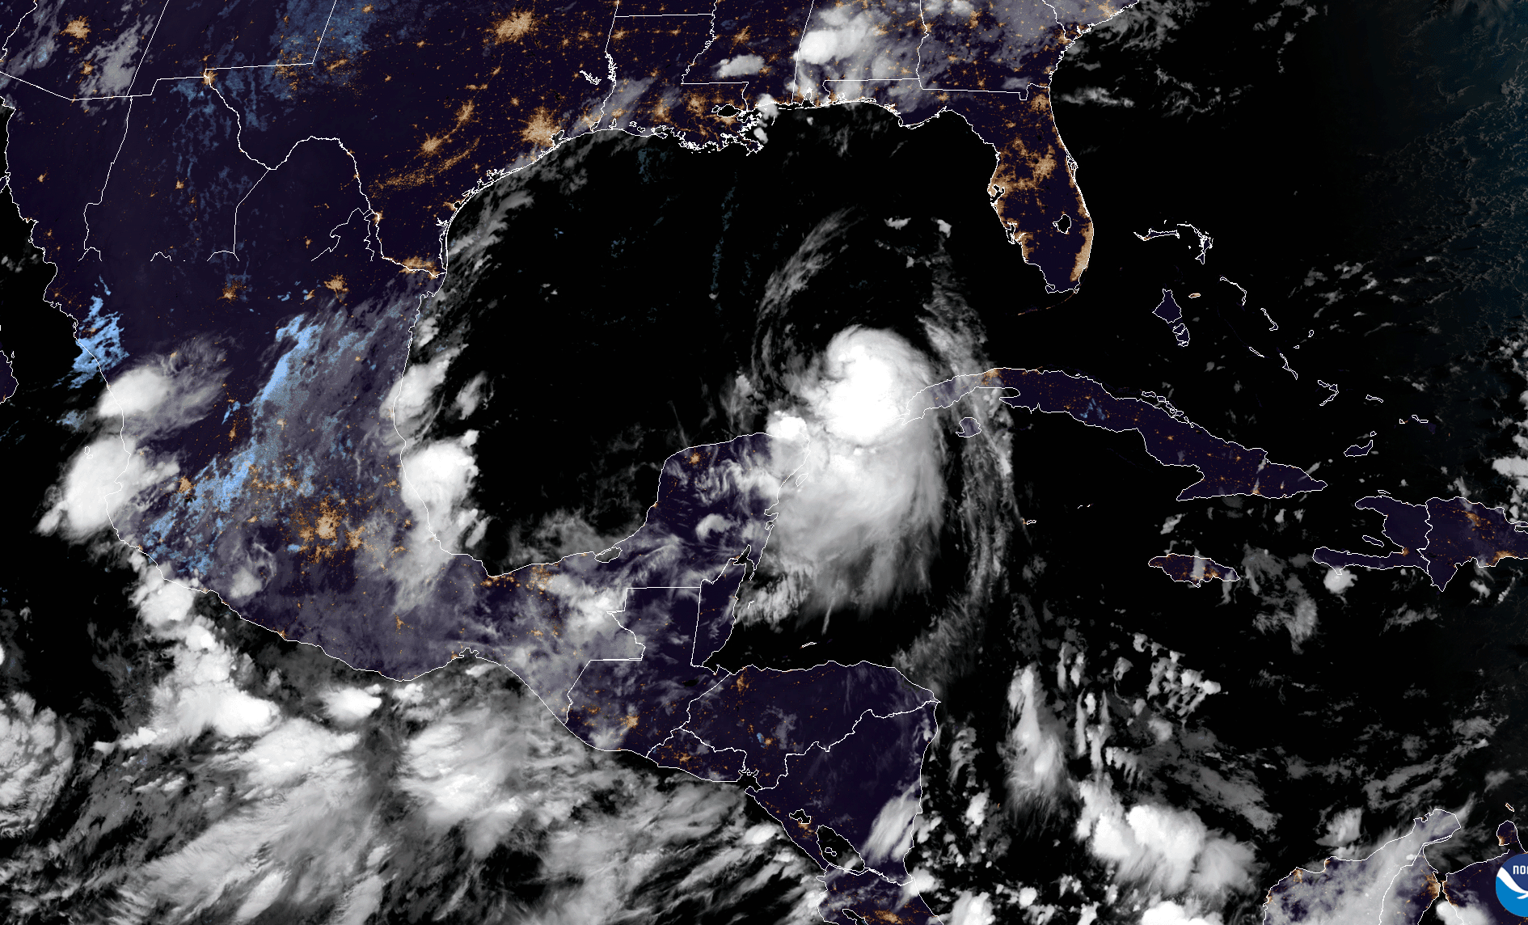
NOAA protects life and property.
Photo by Annie Gentile
NOAA measures how much it rains using rain gauges.
Weather forecasters help keep people safe during storms like tornadoes.
NOAA tracks and studies hurricanes, and other weather events.
Notes:
SLIDE 3 (NWS):
Have you ever watched or heard someone explain what is happening with the weather ? They rely on NOAA for all of their data and information.
NOAA uses satellites, planes, ships, balloons, buoys, computers, and many other technologies to gather data about weather.
With this data NOAA is able observe and forecast the weather and share that information so that your local weather source or app can tell you what the weather is like.
NOAA also issues weather alerts. Maybe you have heard a storm warning on the TV, radio, or smartphone? Maybe a tornado warning siren or alert on your phone? Or maybe seen information about a hurricane? All this information comes from NOAA and their team of forecasters help to make sure that the information reaches people like you so you can be prepared.

Slide 4
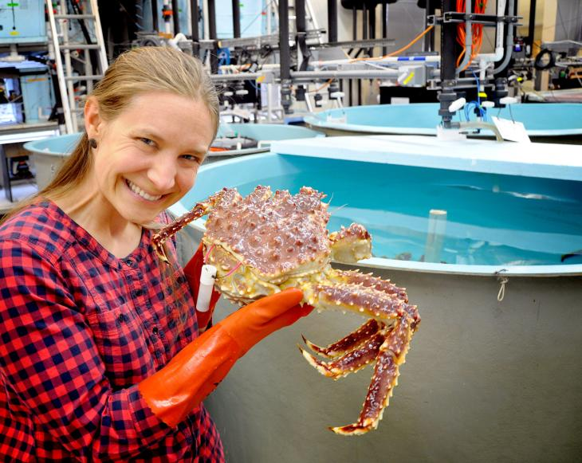
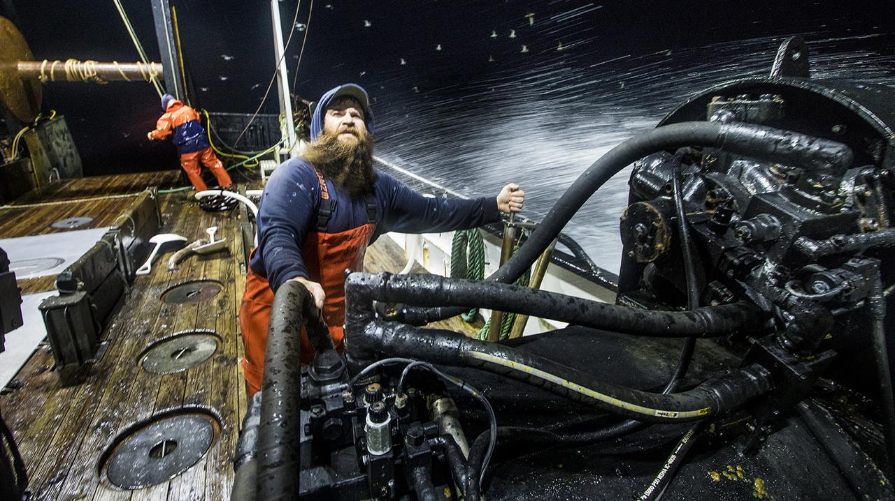
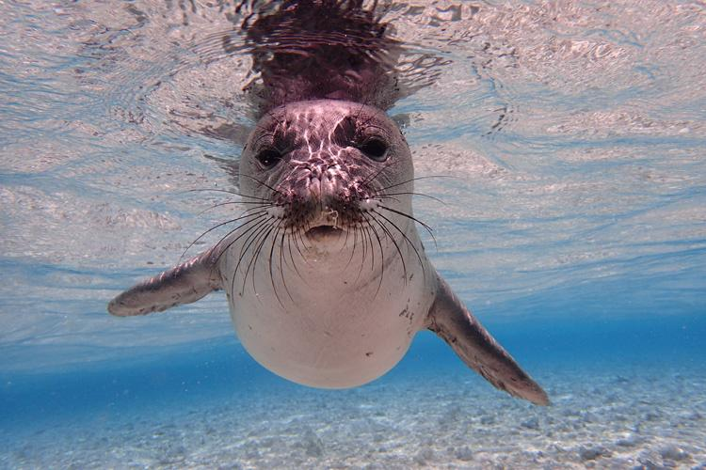
NOAA protects our fisheries and marine life.
NOAA helps crabs to grow.
NOAA supports fish and people who catch fish.
NOAA protects marine mammals like the Hawaiian monk seal.
Notes:
SLIDE 4 (NMFS):
A big part of NOAA is helping to do research and writing regulations that protect over 160 endangered species, including whales, turtles, seals, corals, and fish.
NOAA’s staff go out on ships, planes, beaches, and rivers to conduct this research, sometimes counting fish using radar, or catching a marine mammal to put on a tracking tag to understand where it travels and how it behaves.
NOAA helps people who go fishing in the ocean to understand how many fish and shellfish they can catch each year to ensure there are plenty of fish left in the sea.
NOAA works with many partners, state and local governments, and tribal nations to provide data and information to aid in making decisions.

Slide 5
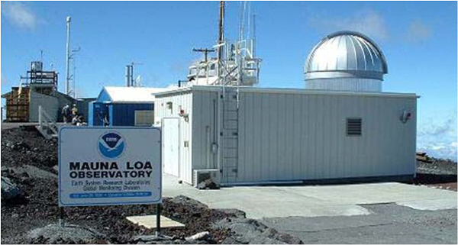
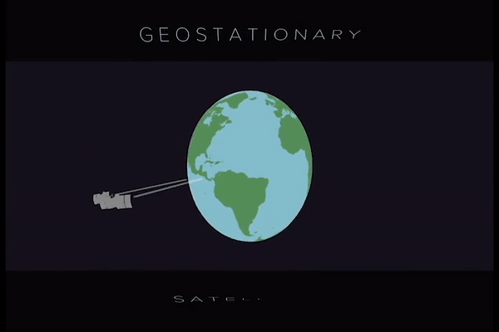
NOAA models and predicts our climate.
NOAA researchers also take measurements of what is in the air to help protect people and the planet.
NOAA Satellites gather data that can tell us how the Earth is changing.
Notes:
SLIDE 5 (OAR):
To help NOAA provide all this information to the public, NOAA relies on their scientists and researchers to gather the data and take the measurements.
NOAA staff use many different methods and technology to collect data like ocean temperature.
NOAA also explores the planet. Using boats, planes, and drones we are able to go to the deepest reaches of the sea to find new species and habitats never seen before and monitor atmospheric conditions.
NOAA also tracks the climate, taking regular measurements of air and ocean water over many years to understand how the climate is warming. This data can help make decisions about how to protect our earth, prepare for a warming climate and take actions to reduce greenhouse gas pollution that is warming our planet.
Did you know that we know more about Mars than we do about our ocean?
Staff at NOAA are helping us each day to learn and explore the world around us.

Slide 6
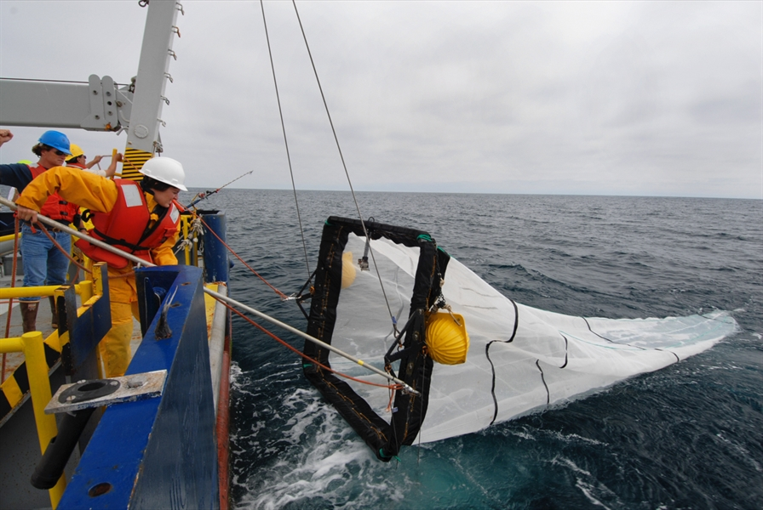
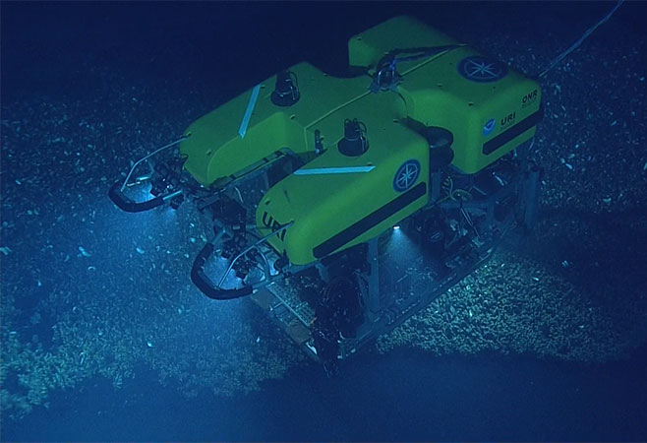
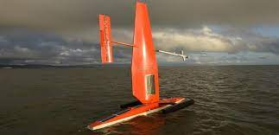
NOAA studies and explores
the planet.
NOAA monitors ocean marine life.
NOAA uses remotely operated vehicles, like Hercules.
NOAA has sail drones that travel long distances and even go into Category-5 hurricanes.
Notes:
SLIDE 6 (OAR/NESDIS/NWS):
Remember when I said NOAA works from the surface of the sun? NOAA uses satellites to gather information about weather out in space. Yes, there is even weather out in space! Space weather can affect everything we do on the Earth, from flying planes, to operating satellites, to planting crops so it’s important that NOAA is able to gather this data and share it with us and other countries around the world.
NOAA currently operates 15 satellites at NOAA which monitor weather, environment, and space weather. (as of March 2022)
Satellites can take pictures of the earth from space, which tells us important things about conditions here on Earth. Satellites help NOAA forecast the weather, track harmful algae in the Great Lakes that could affect drinking water, and can help monitor sea level rise.

Slide 7
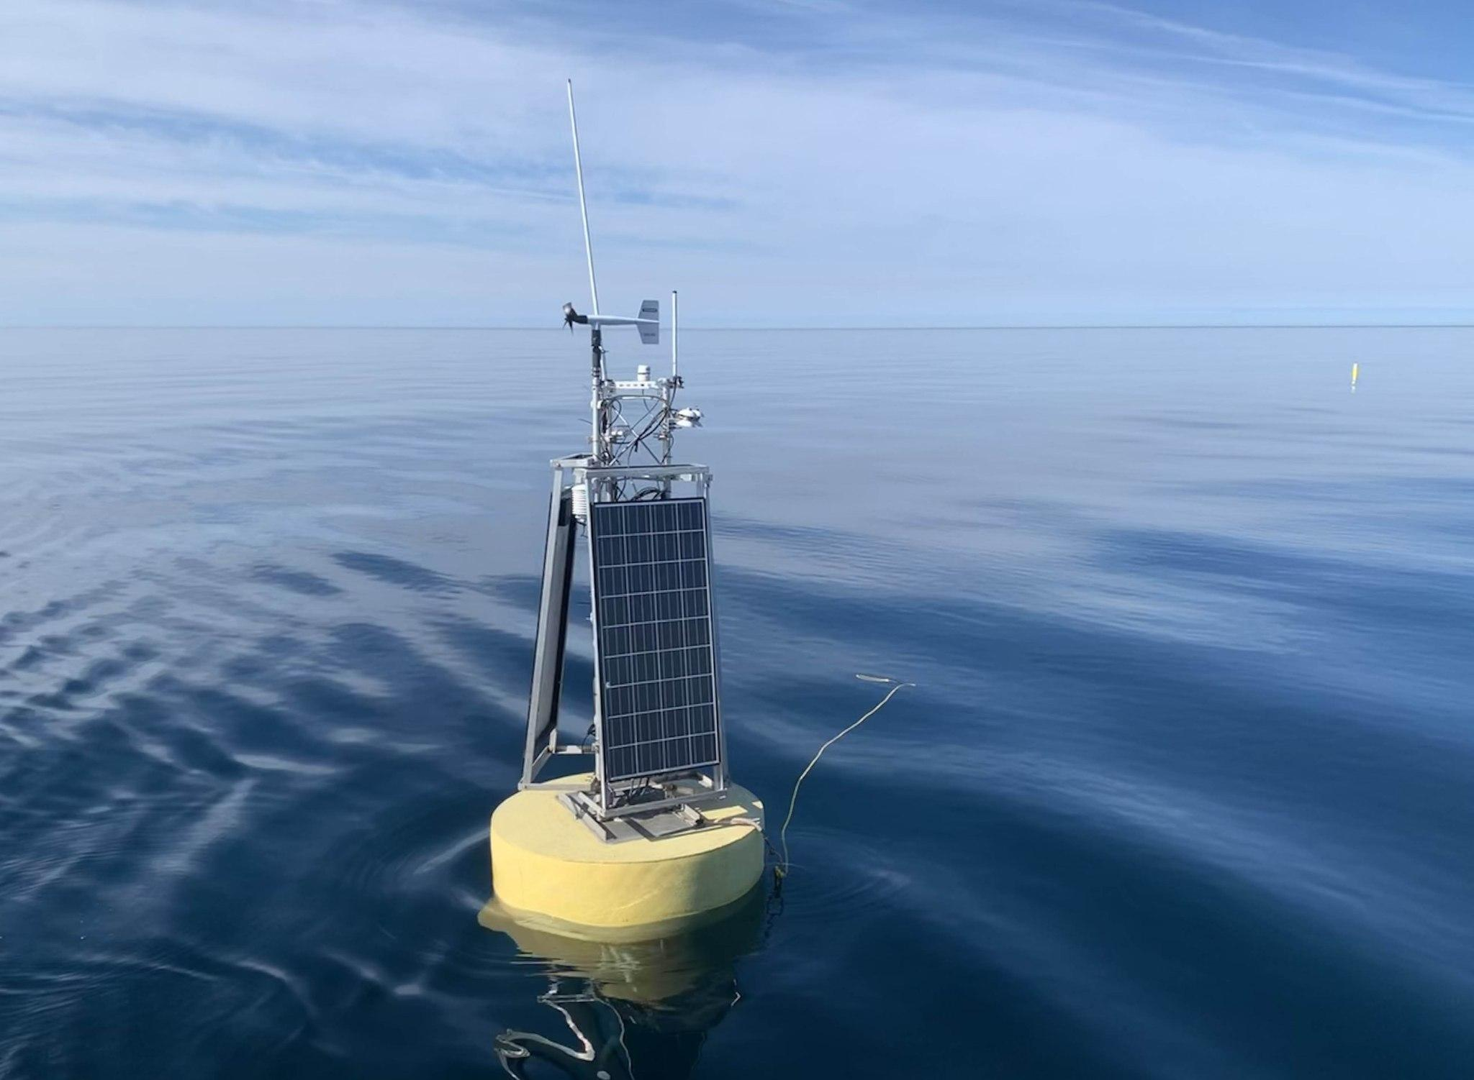
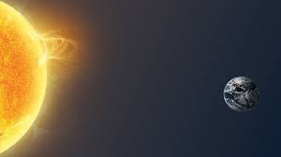
NOAA collects and shares
Earth science data.
Space has weather too! NOAA watches the Sun, which causes weather in space.
NOAA buoys in the Great Lakes make drinking water safe.
Notes:
SLIDE 7 (NESDIS):
In addition to satellites monitoring weather and space weather, some of them also help us to understand the Earth’s climate. Climate is different from weather in that weather is short term and climate is a long term look at changes to conditions on our planet.

Slide 8
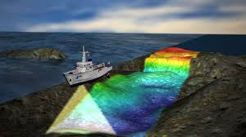
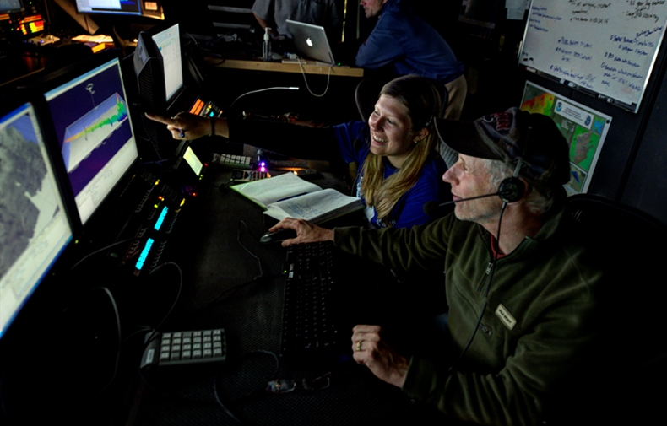
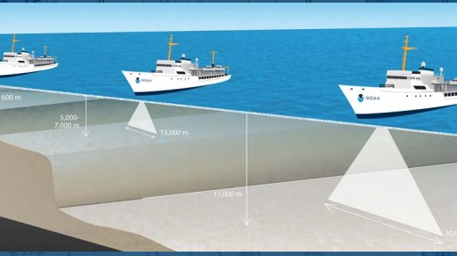
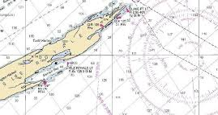
NOAA maps our waters.
Many NOAA staff work onboard ships.
NOAA ships map coastlines and explore the ocean.
NOAA makes maps to help ships sail safely.
Notes:
SLIDE 8 (NOS):
NOAA is responsible for preserving and enhancing the nation’s coastal resources and ecosystems along 95,000 miles of shoreline and bordering 3.5 million square miles of coastal, Great Lakes, and ocean waters.
NOAA also keeps ships safe by upgrading ocean maps, surveying the seafloor, responding to emergencies at sea, and searching for underwater obstructions that pose a danger to navigation.
NOAA has been doing this work for over 200 years! Thomas Jefferson created the Office of Coast Survey back in 1807, NOAA has been keeping ships safe ever since.

Slide 9
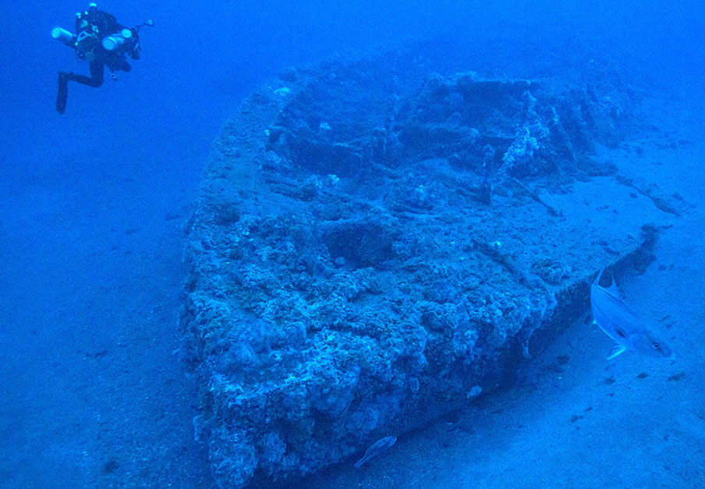
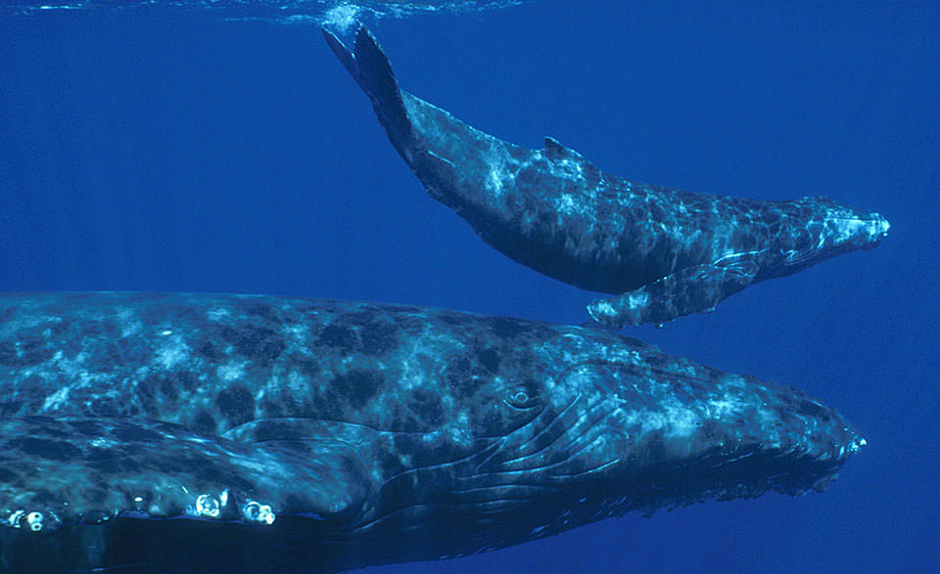
NOAA promotes conservation
and history.
NOAA divers look at shipwrecks to help learn more about history.
NOAA scientists study whales to understand how we can better protect them.
Notes:
SLIDE 9 (NOS/NMS):
Just like national parks on land, there are underwater parks. NOAA oversees a network of underwater parks, known as national marine sanctuaries and marine national monuments, protecting more than 600,000 square miles of marine and Great Lakes waters from Washington state to the Florida Keys, and from Lake Huron to American Samoa.
These areas include historical shipwrecks and important habitat for ocean life as well as preserving areas for recreation, fisheries, and commerce.

Slide 10
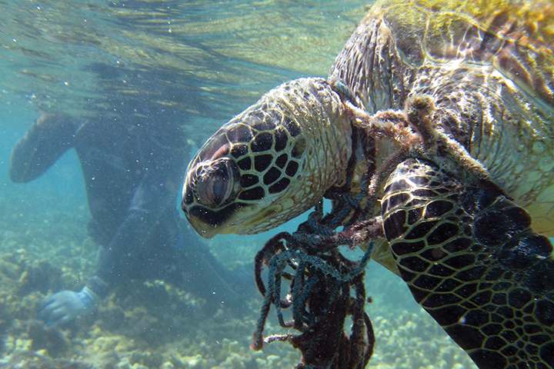
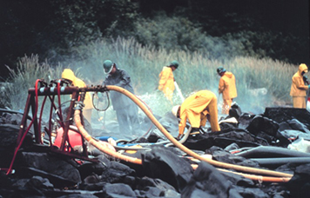
NOAA protects our oceans, Great Lakes, and coasts.
NOAA helps to remove trash from the water that can hurt marine life.
NOAA scientists study oil and chemical spills to help keep people and the environment safe.
Notes:
SLIDE 10 (NOS):
Like the marine sanctuaries and monuments, NOAA is responsible for conservation and protection in federally managed waters. NOAA staff works hard to address negative impacts to marine and human life like marine debris and oil spills.

Slide 11
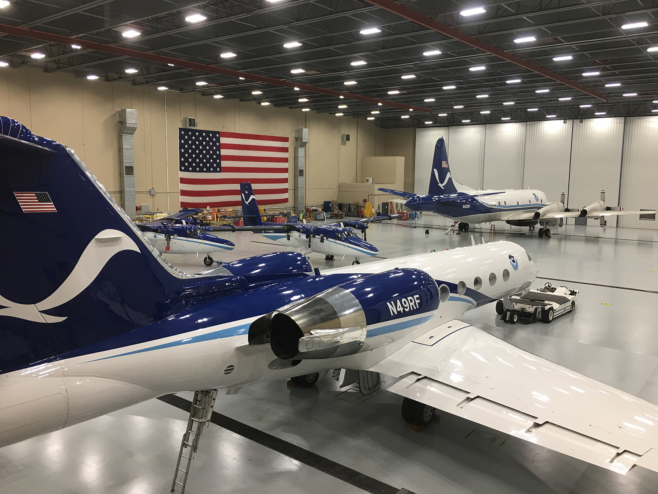
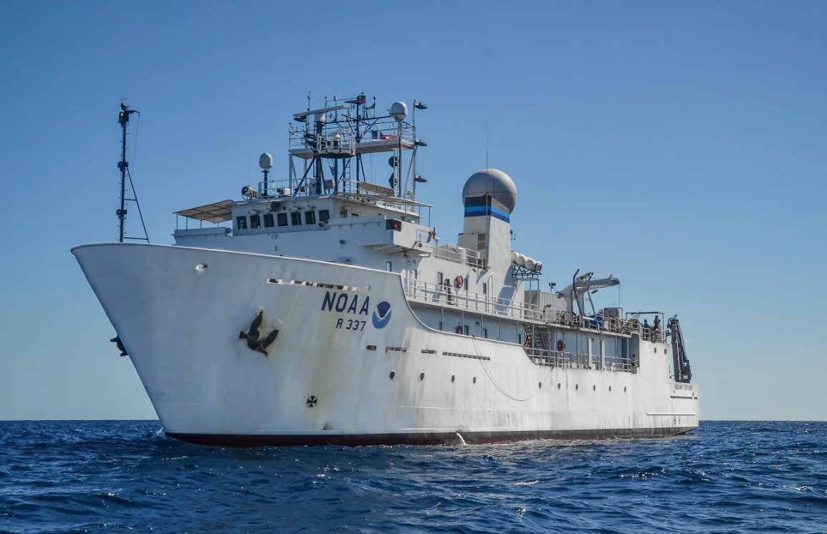
NOAA works in the sky
and the sea.
NOAA aircraft fly into hurricanes, over snow packs, and along coastlines.
NOAA ships study marine life and ecosystems and explore waterways from oceans to inlet.
Notes:
SLIDE 11 (OMAO):
The NOAA Commissioned Officer Corps (NOAA Corps) is one of the nation’s eight uniformed services, just like the military branches you might know like the Army or the Navy. These officers are responsible for the operation of NOAA’s fleet of ships and aircraft.
NOAA ships and their crew work in all types of marine environments from the smallest bays to the open ocean all in the name of science. NOAA’s larger aircraft fly into and around hurricanes to learn more about the storm and guide possible evacuation efforts. NOAA’s smaller aircraft fly much lower to study snow and soil moisture, collect imagery of coastlines, and help with emergencies.

Slide 12
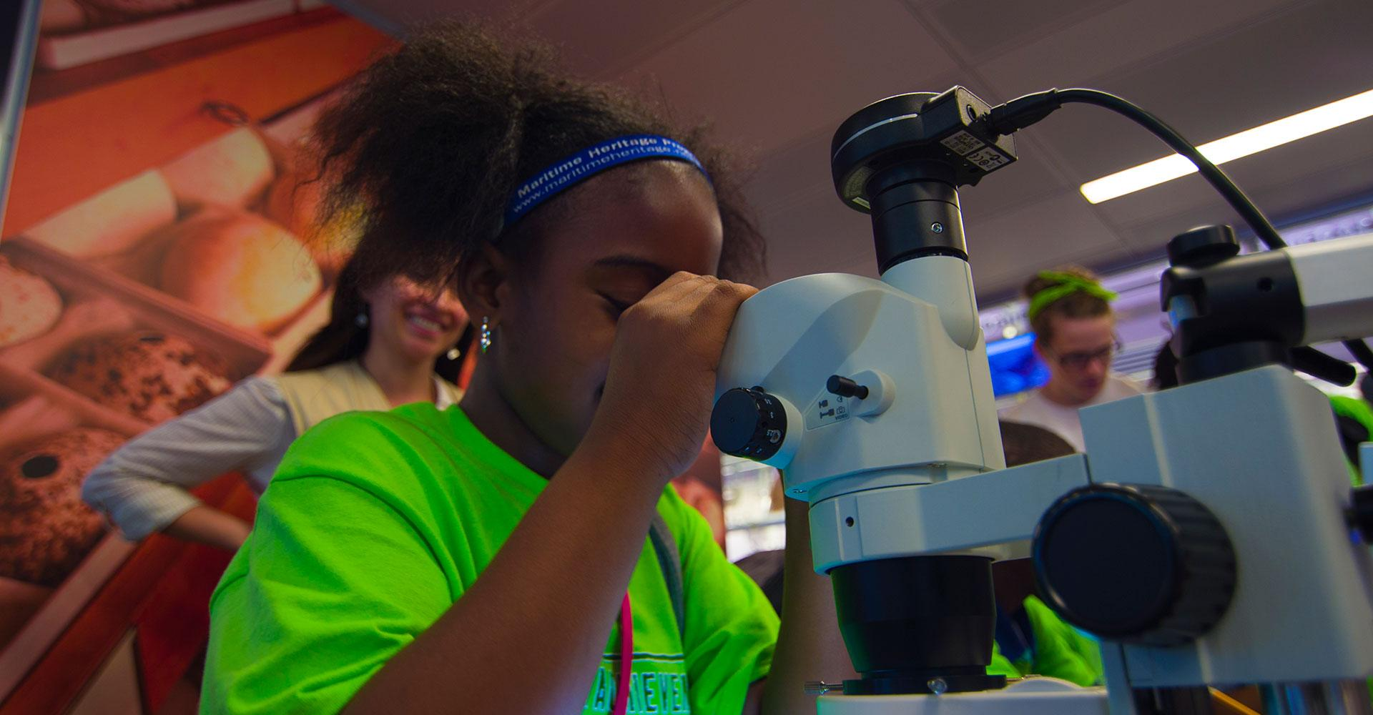
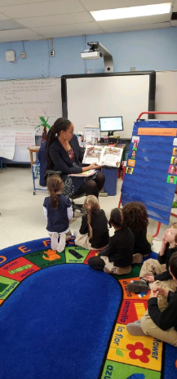
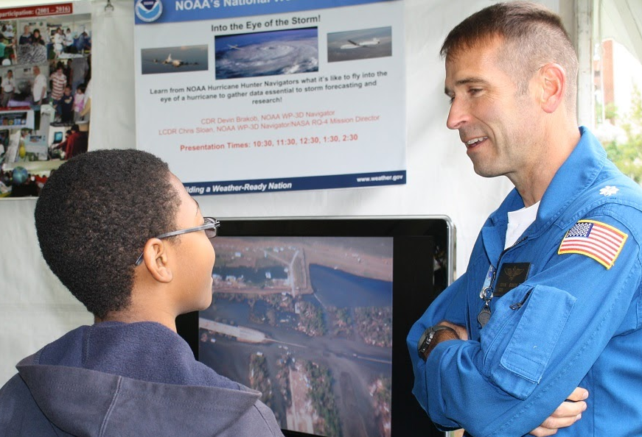
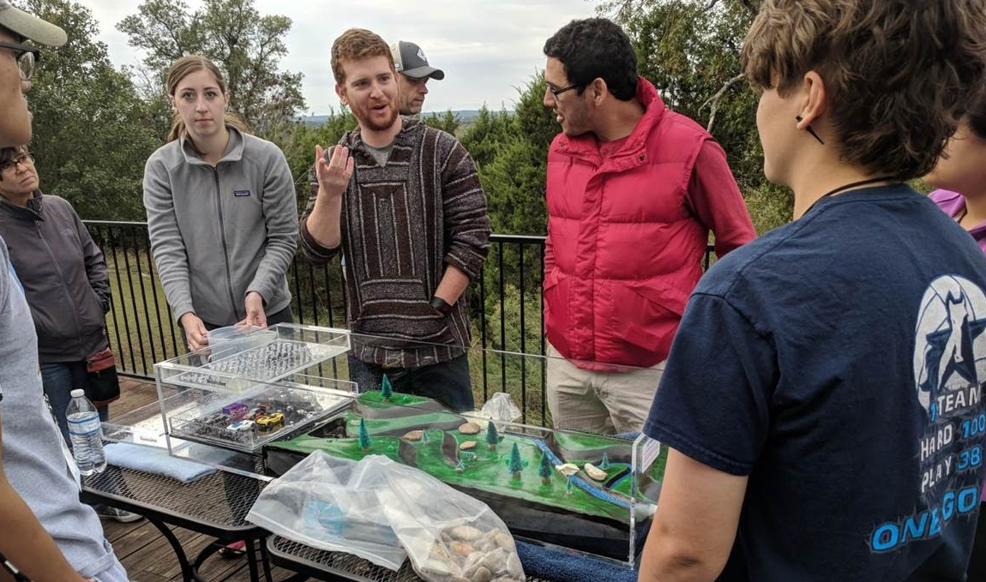
NOAA educates adults and youth.
Notes:
SLIDE 12 (Education):
NOAA also works with local communities to share our knowledge. We go to schools, community events, business, and local agencies to help people understand the world around them.

Slide 13
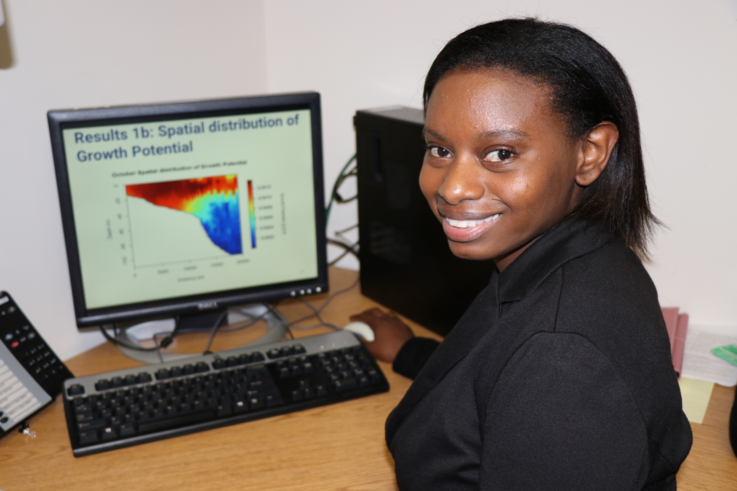
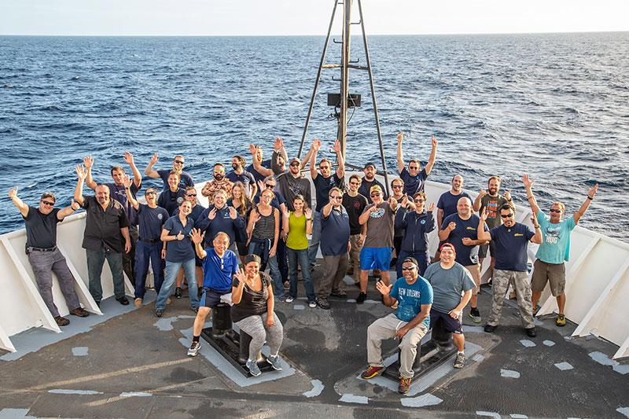
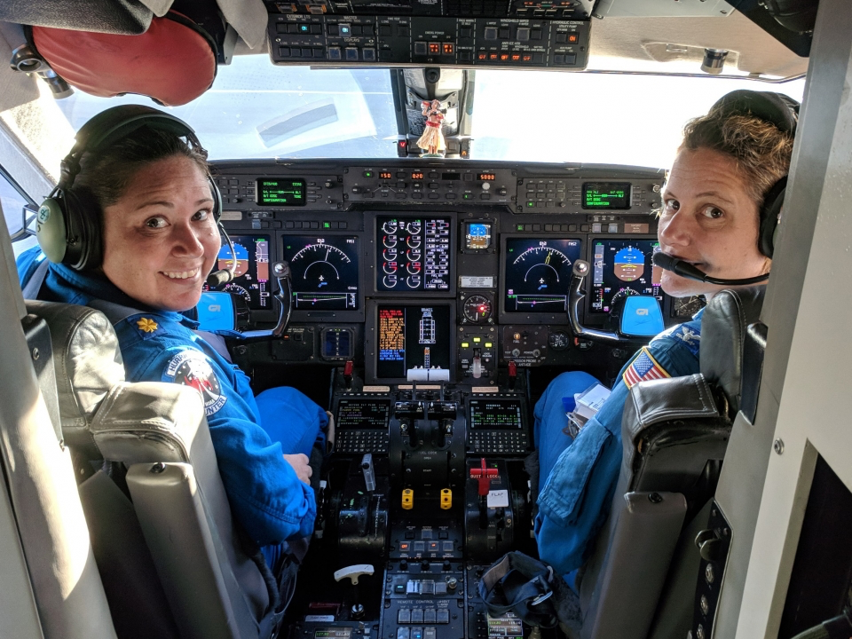
NOAA has great people!
Notes:
SLIDE 13 (Workforce):
One of the best things about NOAA is its people. The NOAA workforce includes folks who are some of the best and the brightest. Whether they are out doing research or working behind the scenes the NOAA workforce all pulls together to provide all the services I talked about today.

Slide 14
NOAA offers many different jobs!
Scientists and researchers
Law enforcement officers
Commissioned NOAA Corps Officers
Policy specialists
Graphic designers
Lawyers
Mariners
Engineers
Administrative professionals
Information technologists (IT)
Facilities specialists
Web developers
Educators
Divers
And more!
Notes:
SLIDE 14 (Careers):
NOAA doesn’t just hire scientists, there are a lot of different jobs! Pretty much every career imaginable can be found at NOAA from educators, to divers, to law enforcement.
These are just some of those jobs people have at NOAA.

Slide 15
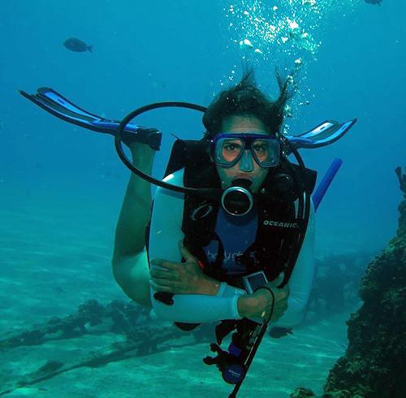
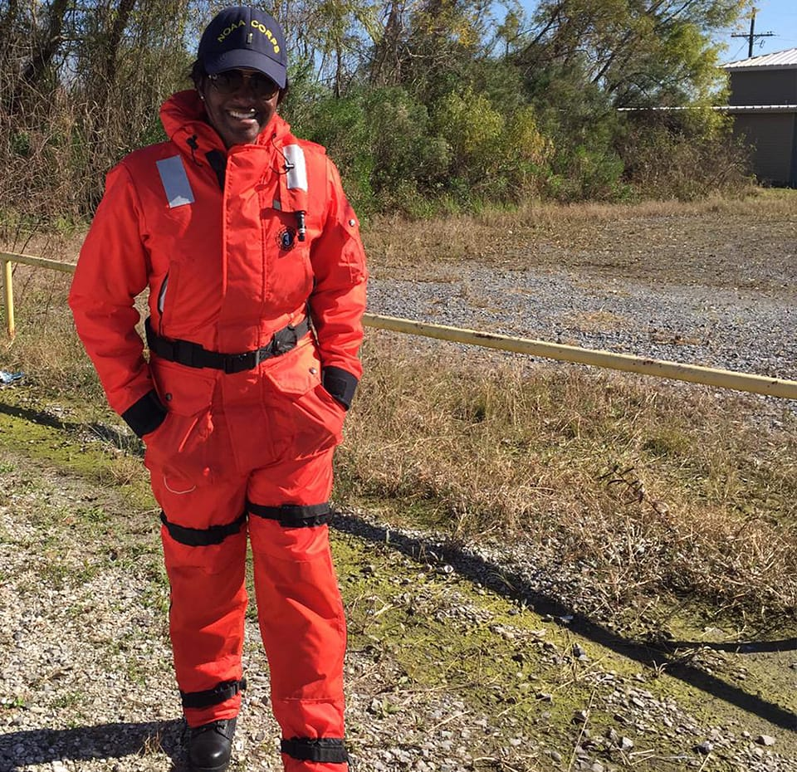
Average Salaries at NOAA*
Meteorologist: $103,000
IT Professional: $115,000
Fish Biologist: $107,000
Administrative Assistant: $56,000
Electronics Technician: $78,000
*Based on data from www.federalpay.org
Notes:
SLIDE 15 (Salaries):
Federal government jobs provide great salaries. Here are some examples of the average salaries at NOAA for select positions within the agency.
Federal employment also brings with it great benefits like vacation time, health insurance, and retirement.
Federal employment isn’t the only way to work for NOAA. Students often come to work with us through a program called Pathways where you can start interning with NOAA and work up to a full time position. Many employees also join through contracting positions.
NOAA is always looking for great people and it’s never too late to consider a career at the agency.

Slide 16
You don’t have to wait!
Ernest F. Hollings Undergraduate Scholarship Program
José E. Serrano Educational Partnership Program with Minority Serving Institutions
John A. Knauss Marine Policy Fellowship Program
Coastal Management Fellowship
Dr. Nancy Foster Scholarship
Find more opportunities at www.noaa.gov/students!
Notes:
SLIDE 15 (Internships):
But, you don’t have to wait until you are in a career to work at NOAA. We have many internships for high school students, undergraduates, and post-graduate students.
These are great ways to start learning about NOAA while exploring what you might want your career to be.

Slide 17
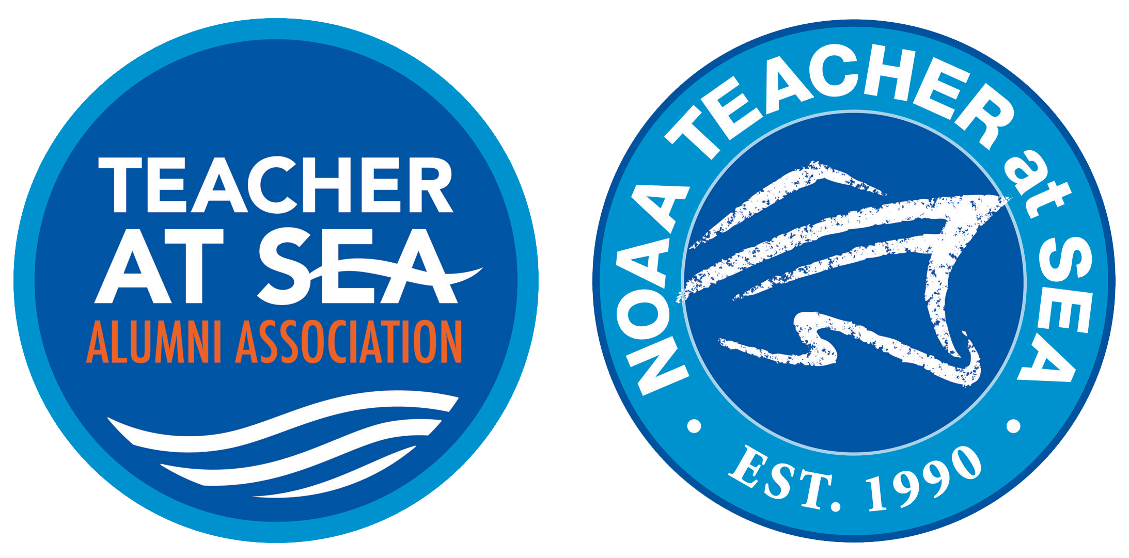
For more information visit noaa.gov
Notes:
END SLIDE:
Thank you very much for letting me come and speak to you about NOAA. Any questions?

Slide 18
Supplement and adapt this presentation by creating and adding your own slides

Slide 19
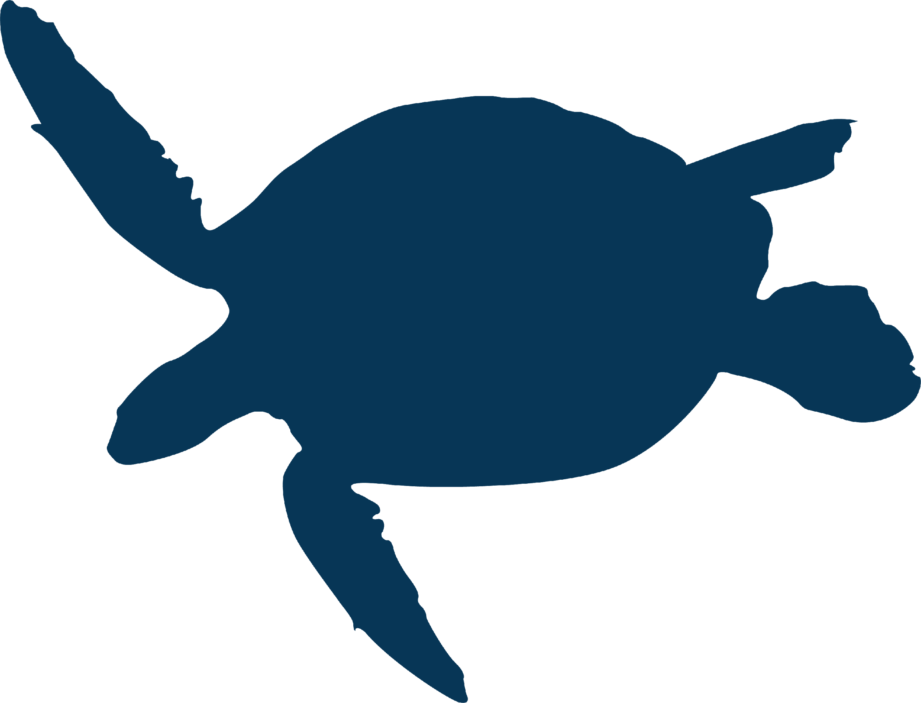
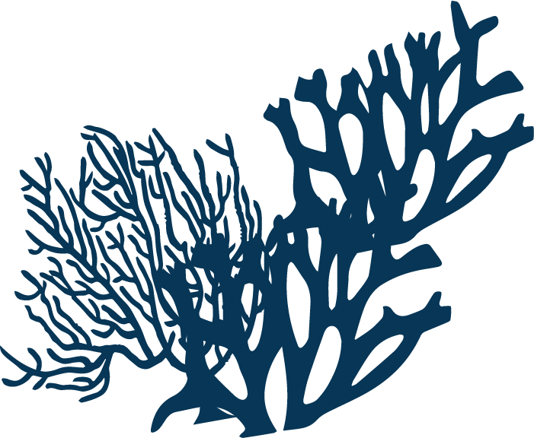
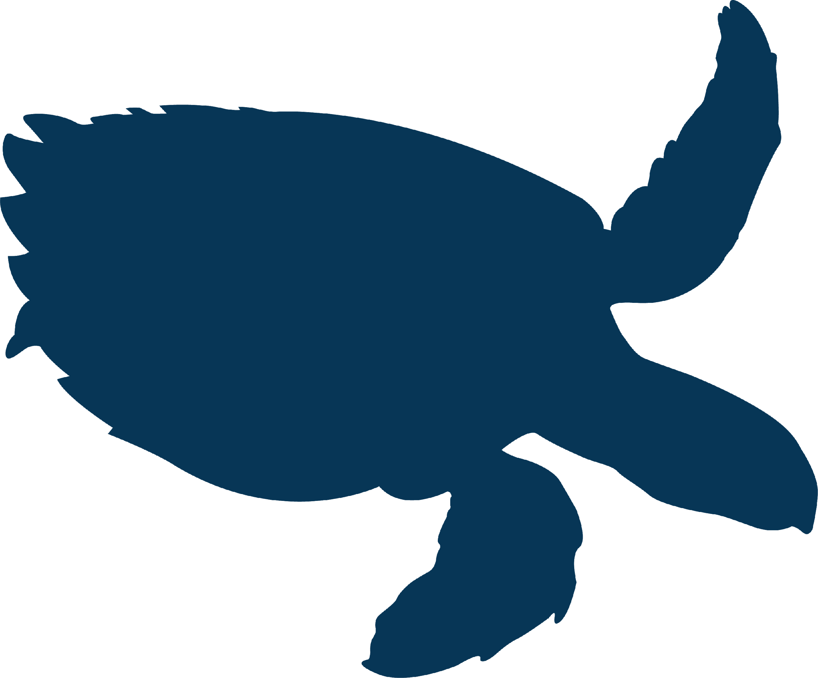
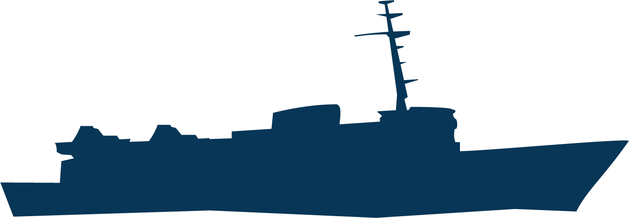
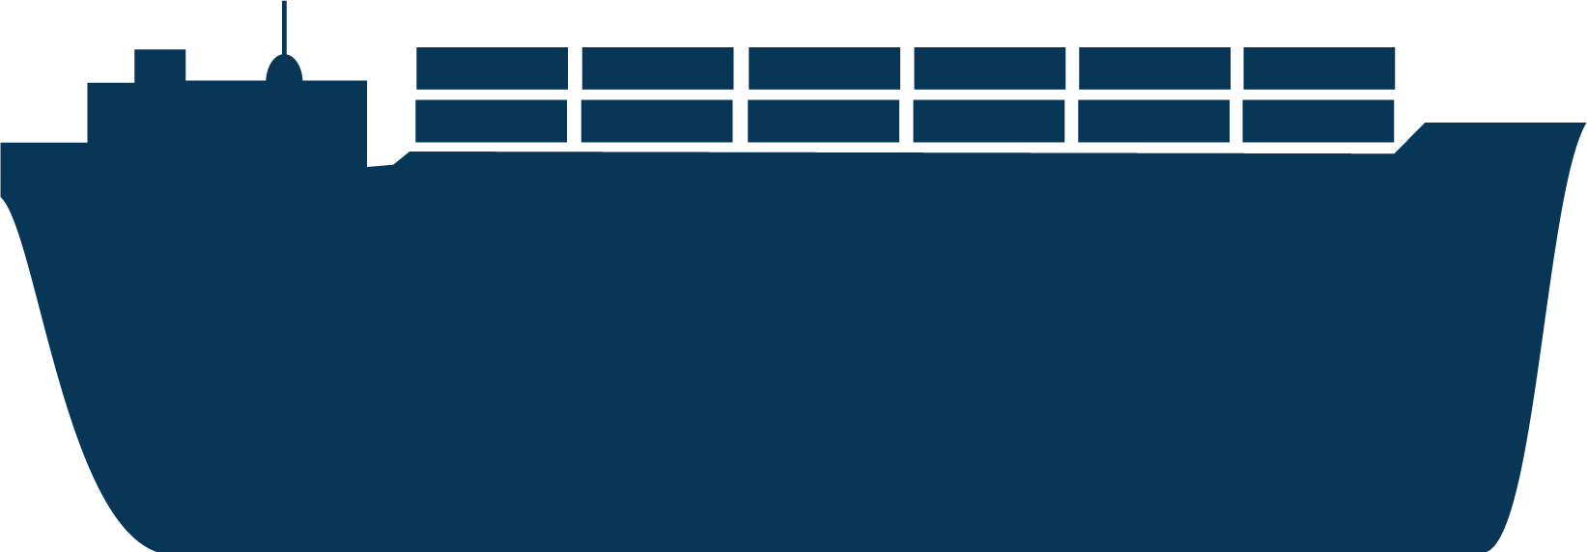
Icon Assets: copy and paste these into slides to add visuals as needed

