Slide 1
NOAA’s Teacher at Sea Program
Living and Learning at Sea

Slide 2
Mission
To provide teachers hands-on,
real-world research experience working at sea with world-renowned NOAA scientists, thereby giving them unique insight into the oceanic and atmospheric research crucial to the nation.​

Slide 3
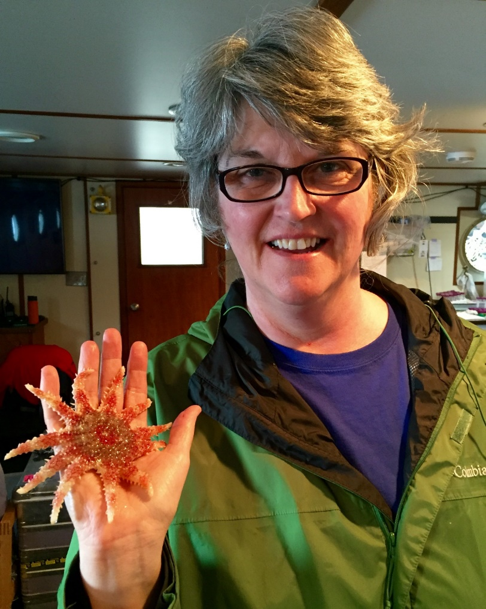
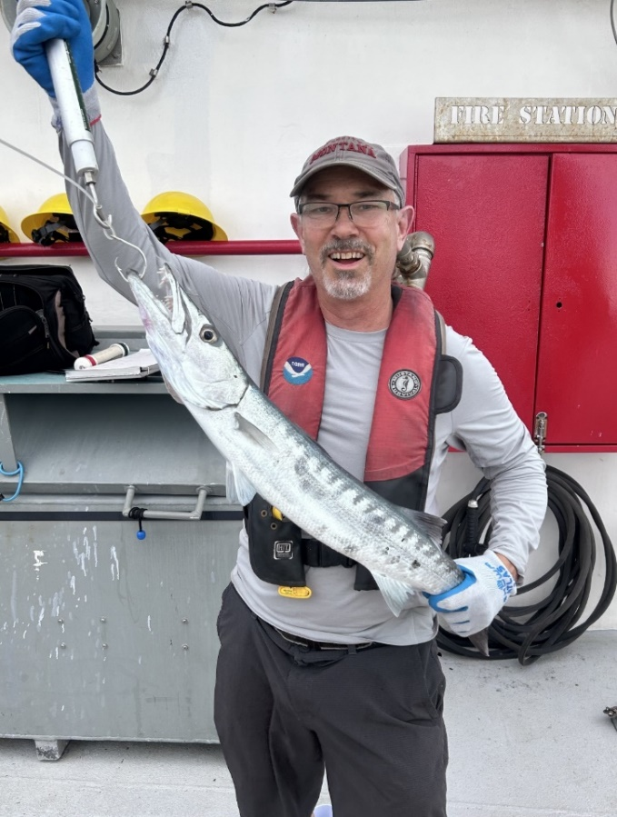
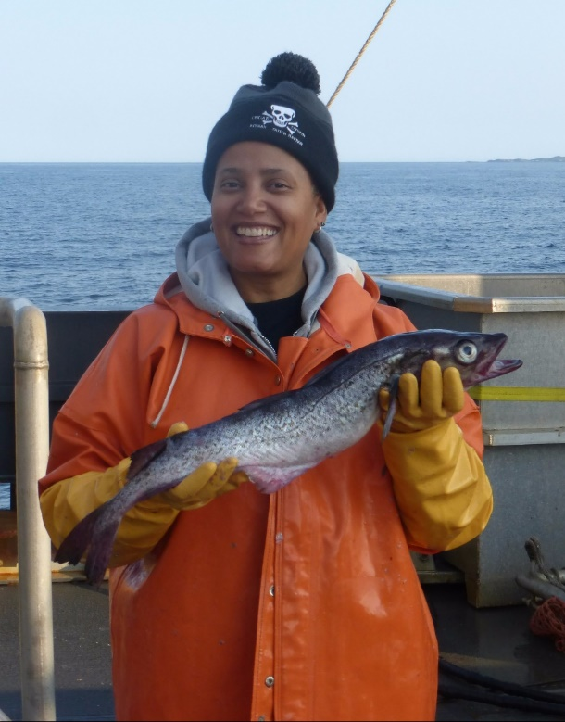
Vision
To be NOAA’s main provider to teachers of opportunities to participate in real-world scientific research and maritime activities through teacher research experiences.

Slide 4
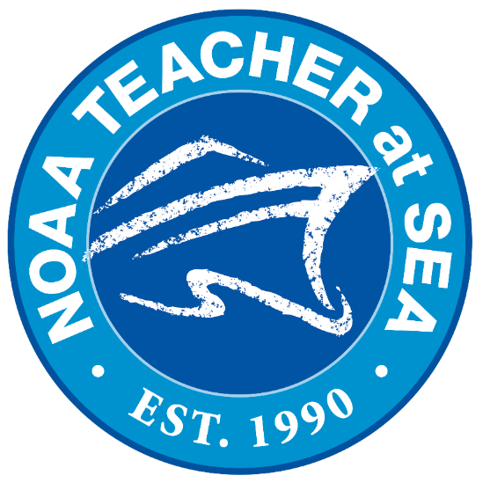
Since the program began in 1990…
875+
Participants have sailed
50+
From every state as well as Puerto Rico, Guam, American Samoa, and DC
Crafting more than
3,200
educational blog posts
Collectively spending 10,000
days at sea
Participating in more than
118,000
hours of ocean-based research

Slide 5
Eligibility
Requirements
U.S. citizen or lawful permanent resident
Online
application
with essay questions
Currently employed as a full-time preK-12 educator, college/university professor, informal educator
Complete health
questionnaire
Receive required
vaccinations
2 letters of
recommendation

Slide 6
When can I apply &
what is the timeline?
5
Participants sail: ~ 2 weeks March - September
4
Cruise placements determined: March - May
Applicants notified of selection: January - February
3
2
Online application open: November
Application preview available: October
1

Slide 7
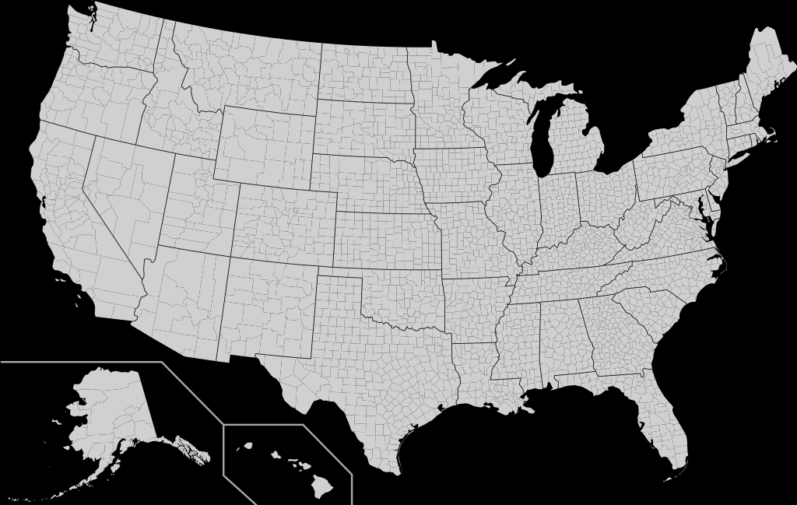
Where do NOAA Teachers at Sea sail?
Gulf of Maine
West Coast
East Coast
Gulf of Mexico
Bering Sea
Gulf of Alaska
Hawai`i

Slide 8
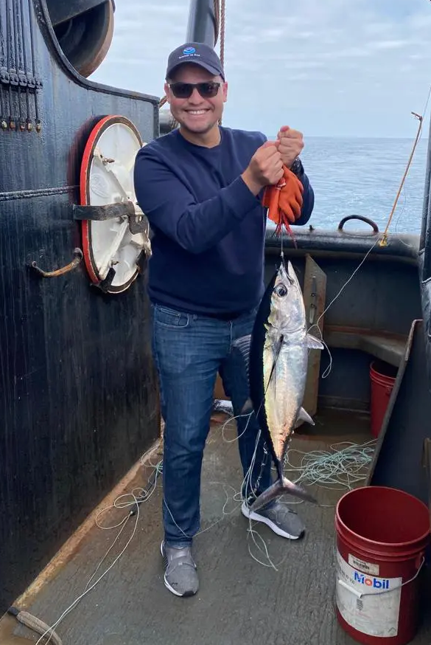
A Day in the Life
While most research cruises last 2-4 weeks, each teacher’s experience is different.
Teachers at Sea are considered members of the science crew. On board, they work at the instruction of the Chief Scientist, and, like all crewmembers, follow the command of the ship’s Commanding Officer or Captain.
Depending on the nature of the research work, the Chief Scientist may assign the teacher to a regular 12-hour shift (including, potentially, overnight work. Ship and science operations happen 24/7.)

Slide 9
3 Main Types of Cruises
Fisheries
Oceanographic
Hydrographic

Slide 10
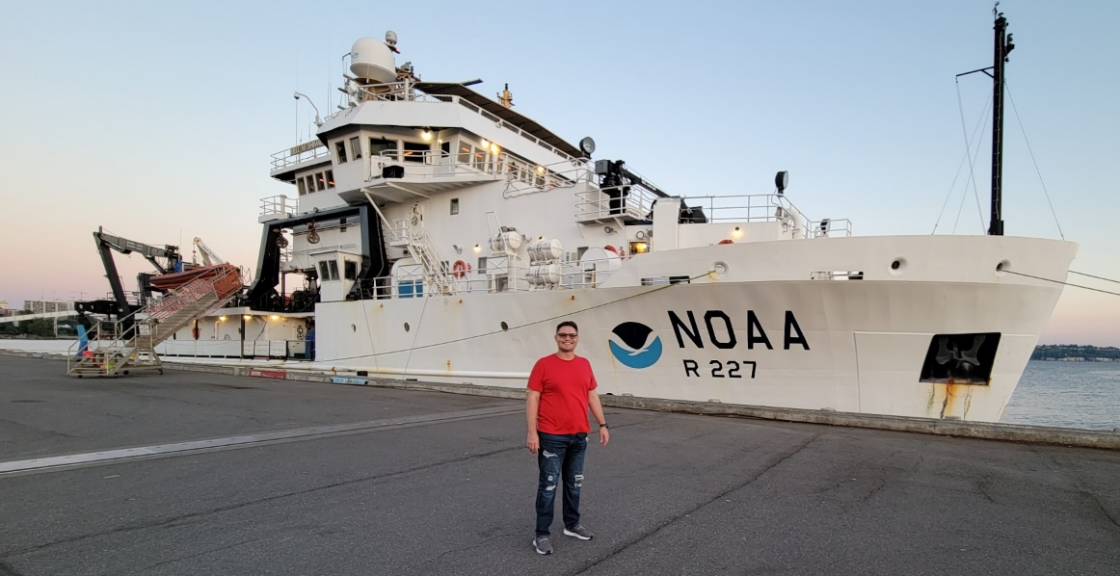
Fisheries Survey Cruises
Fisheries cruises perform biological surveys and physical science studies to help NOAA better understand our nation’s fisheries.
These cruises support NOAA's mission to protect, restore and manage the use of living marine, coastal, and ocean resources through ecosystem-based management. ​
NOAA Fisheries ships include Henry B. Bigelow, Oscar Dyson, Nancy Foster, Hi'ialakai, ​Gordon Gunter, Oregon II, Oscar Elton Sette, Reuben Lasker, and Bell M. Shimada (pictured above).

Slide 11
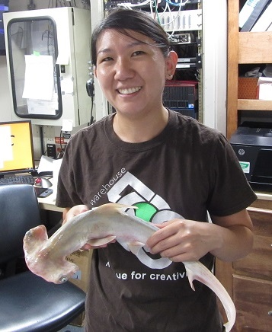
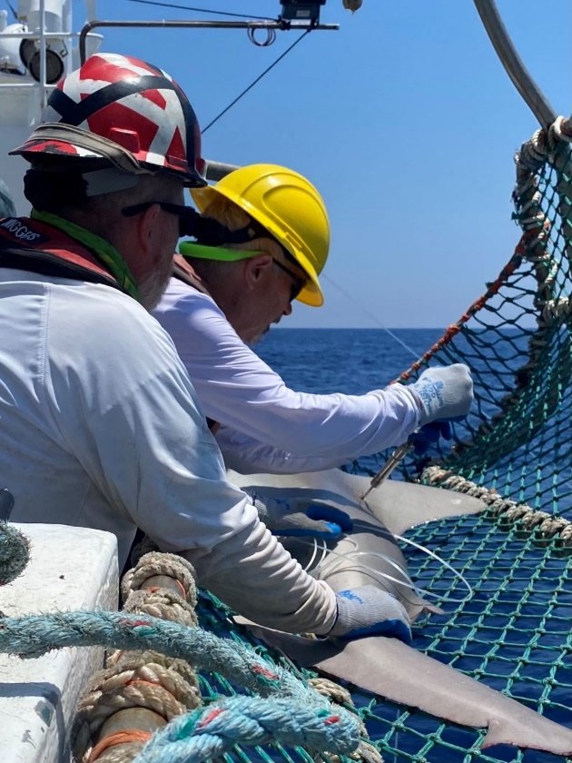
If you sail on a fisheries cruise, you may…
…examine or
tag sharks

Slide 12
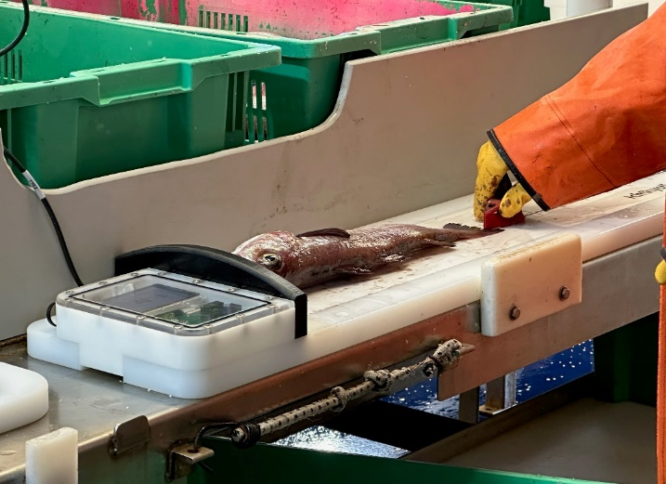
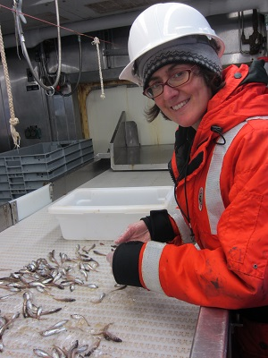
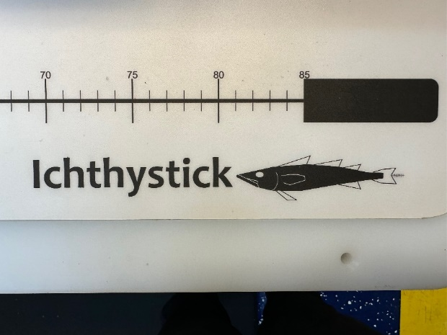
…help sort a
trawl sample and
use an ichthystick
to measure

Slide 13
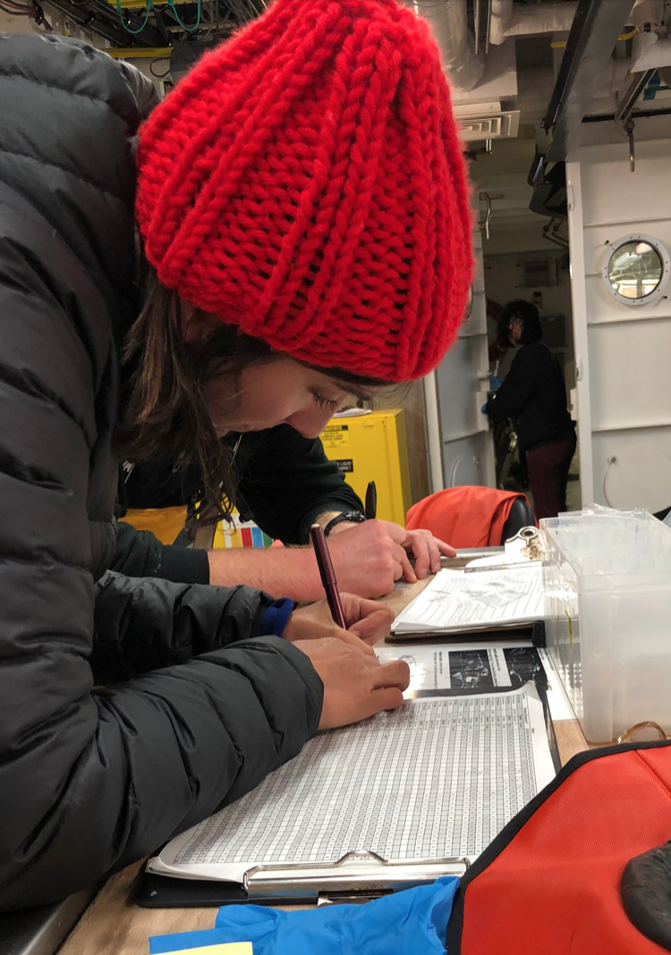
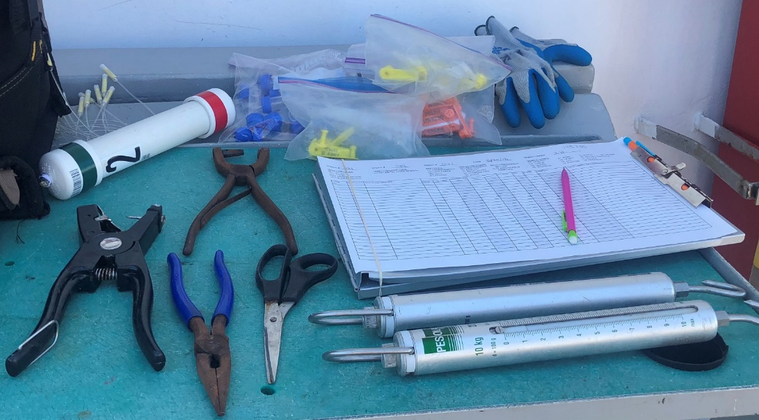
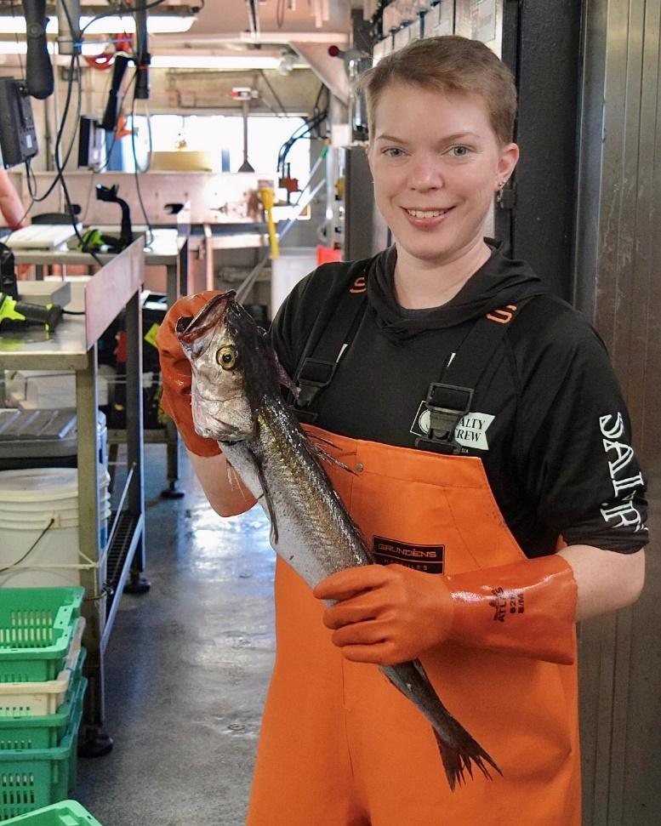
…record data
about various species

Slide 14
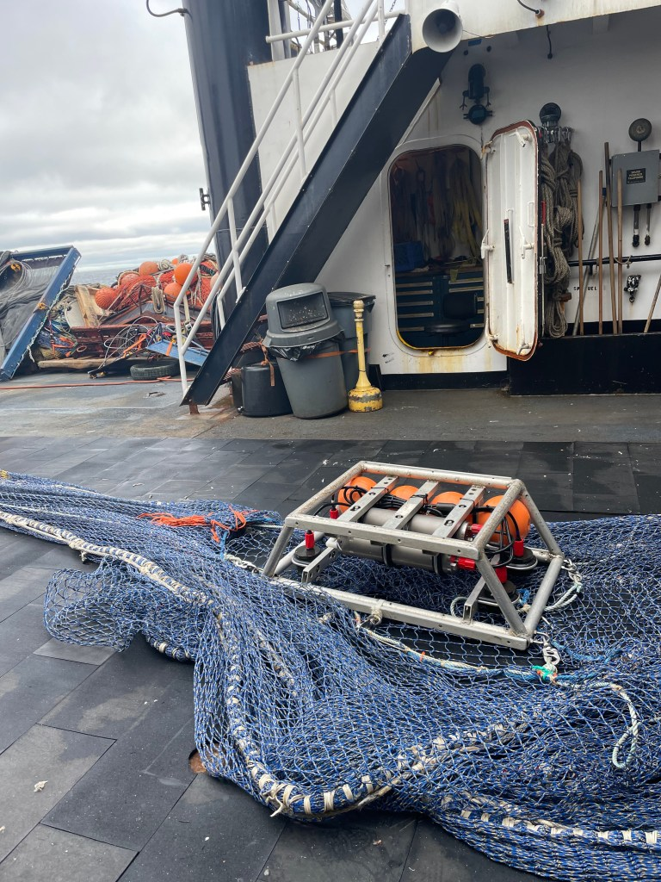
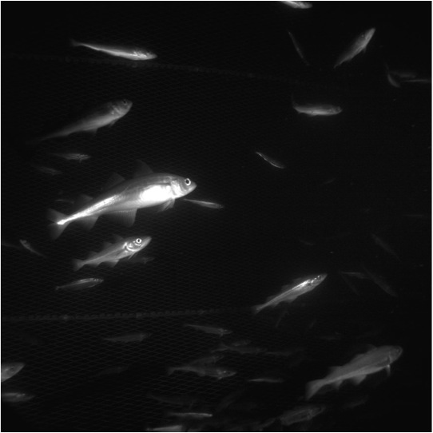
…help deploy an underwater camera and examine
images

Slide 15
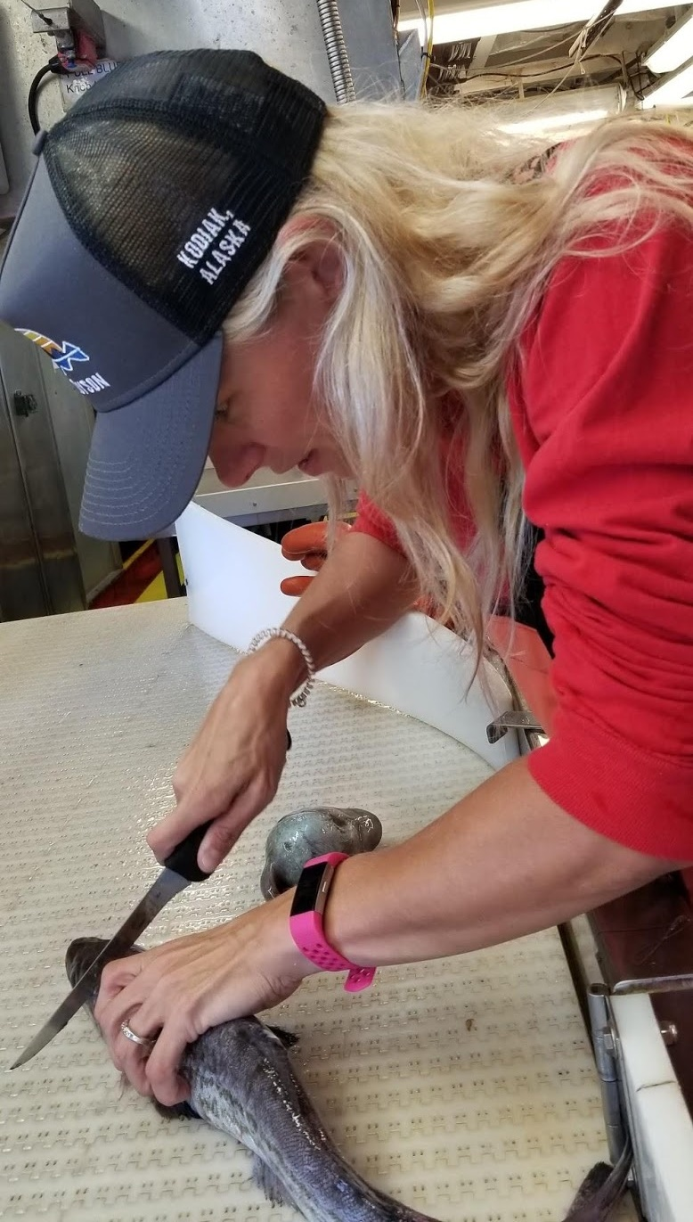
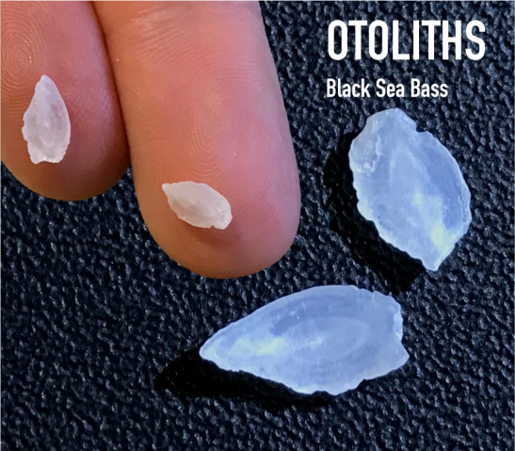
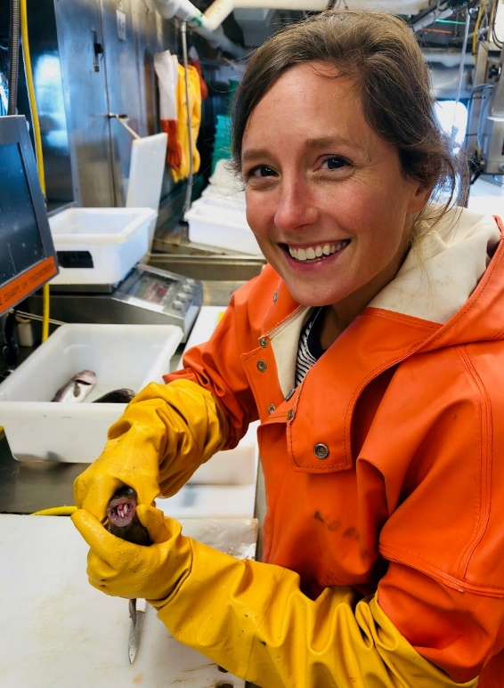
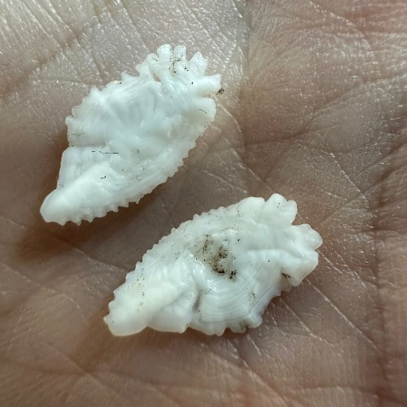
…collect otoliths

Slide 16
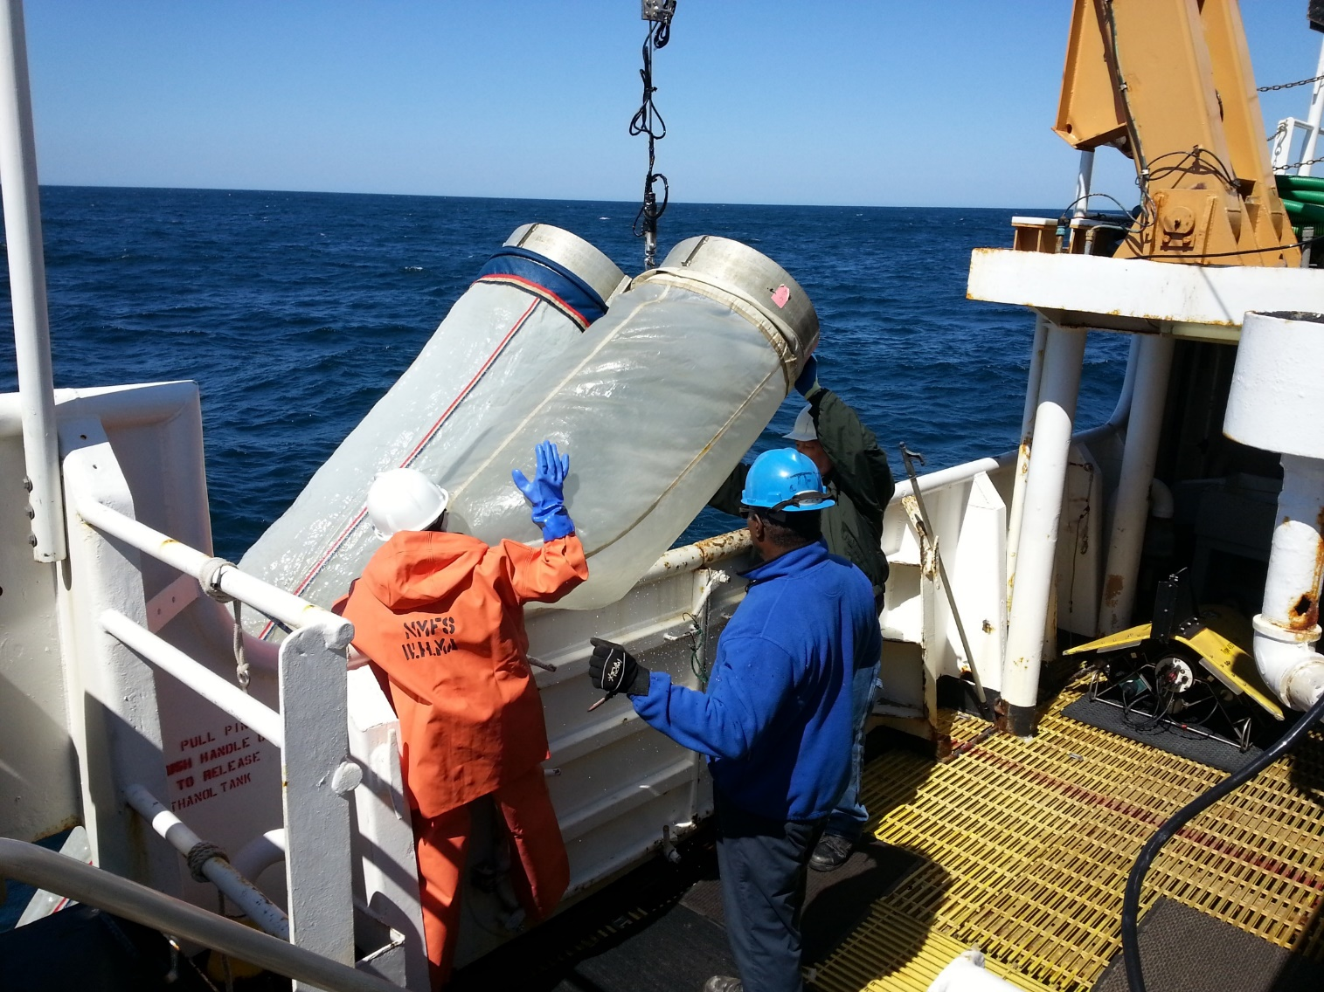
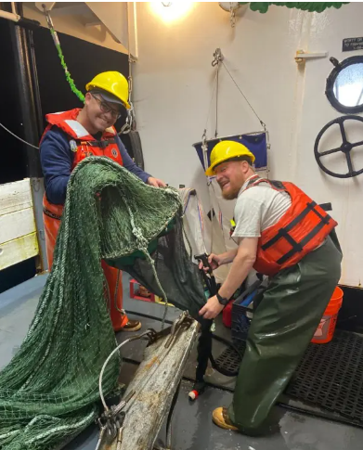
…help deploy a bongo net or midwater trawl to collect samples

Slide 17
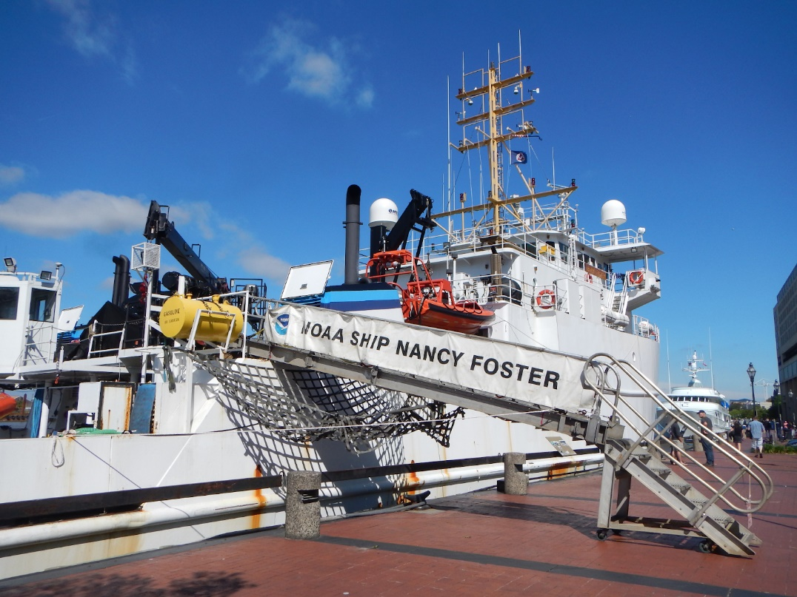
Oceanographic Survey Cruises
Oceanographic cruises perform physical science studies to increase our understanding of the world's oceans and climate. The ships deploy, recover, and service deep sea moorings around the globe that measure ocean currents, ocean temperatures, and atmospheric variables.
They also continuously measure upper ocean currents, surface salinity, carbon dioxide content, and sea-level atmospheric conditions while underway. ​
Oceanographic ships include Ronald H. Brown, Nancy Foster (pictured above), Hi'ialakai, and Okeanos Explorer.

Slide 18
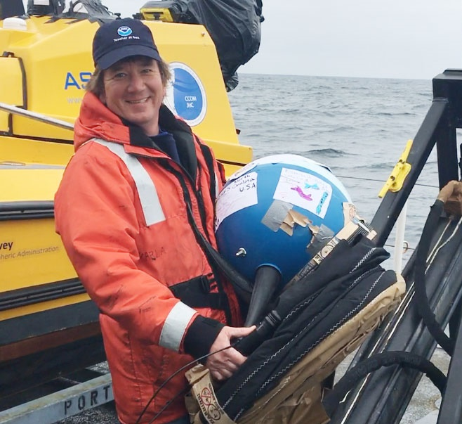
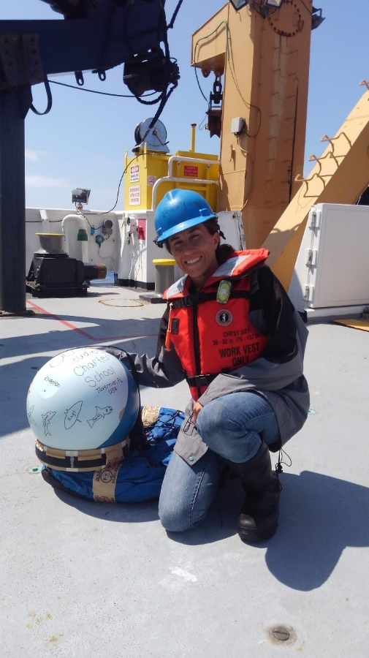
If you sail on an oceanographic cruise, you may…
…deploy a drifter buoy

Slide 19
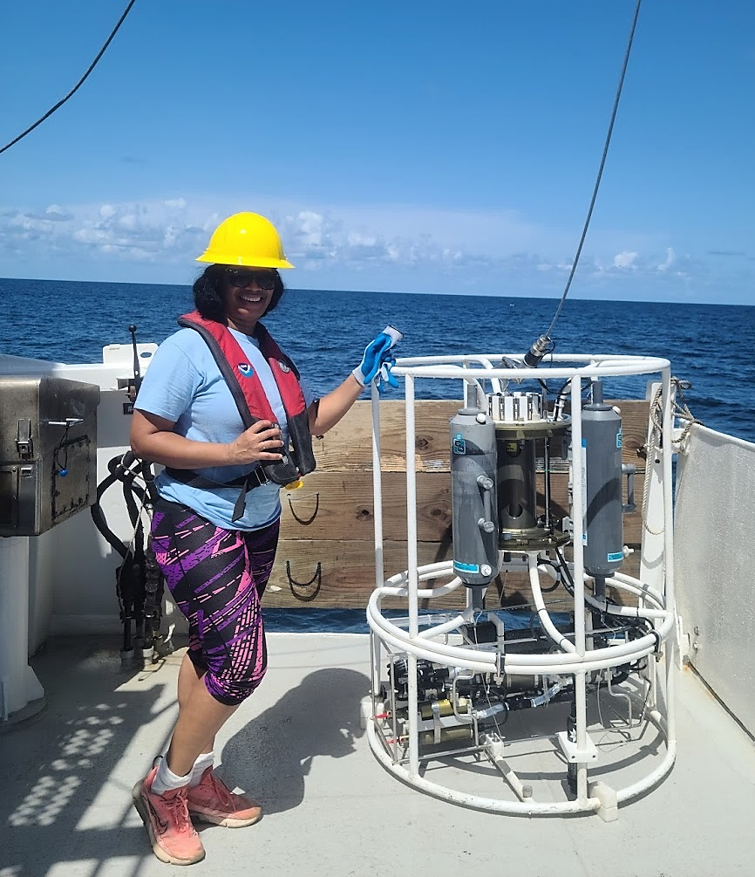
…help deploy a conductivity, temperature, & depth (CTD) instrument

Slide 20
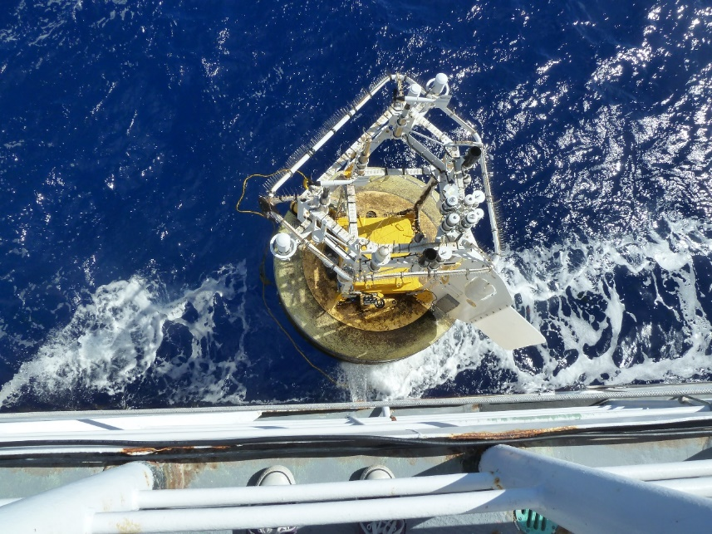
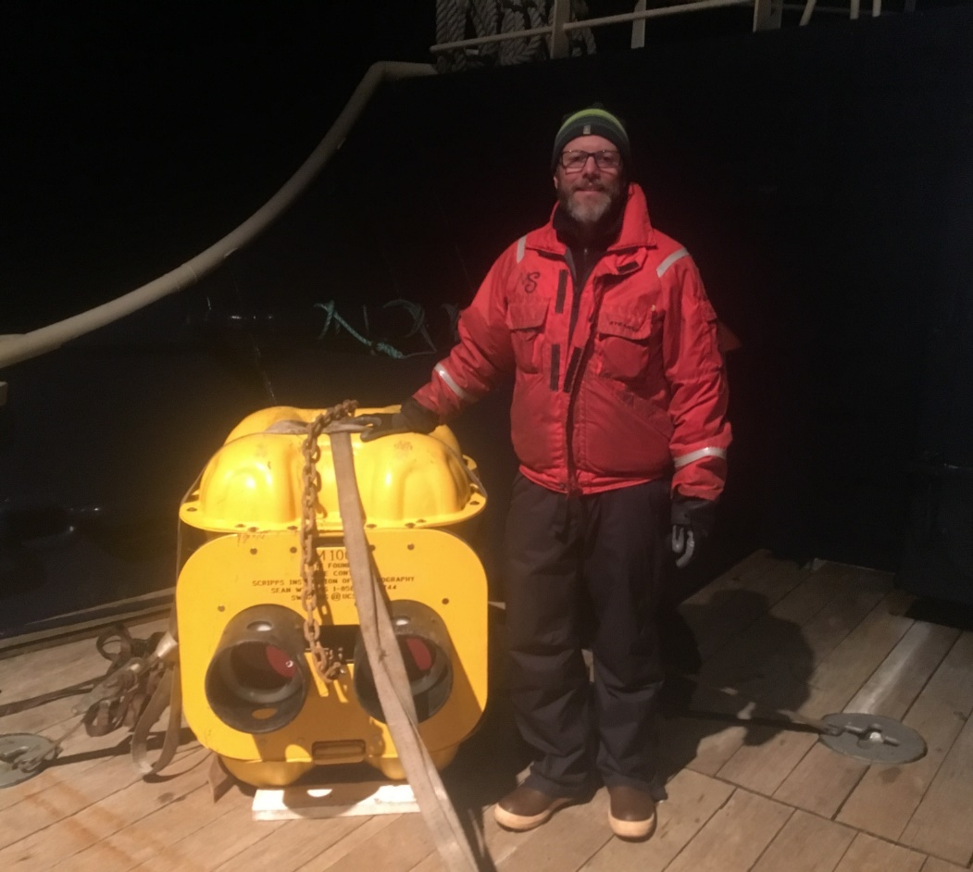
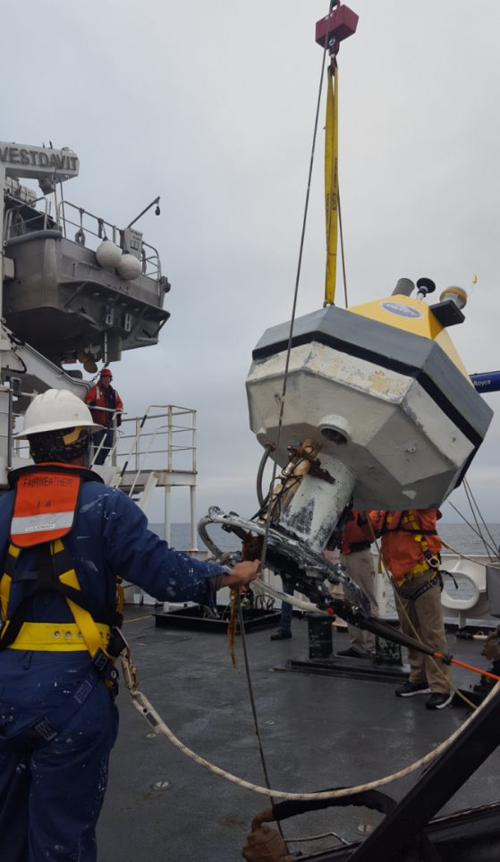
…help deploy or retrieve a data buoy

Slide 21
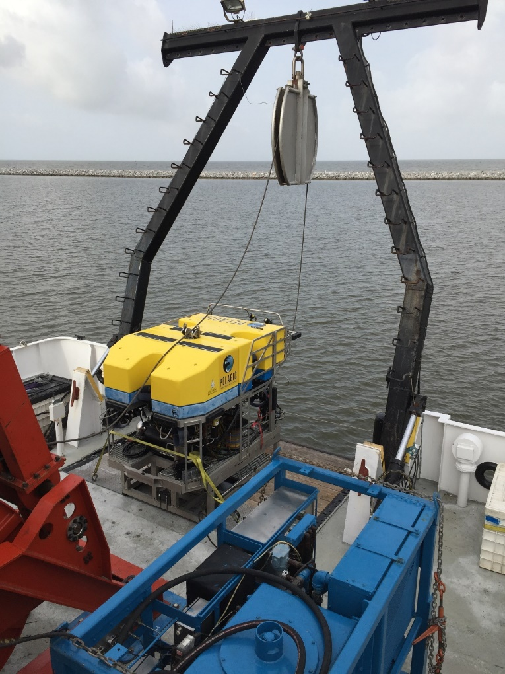
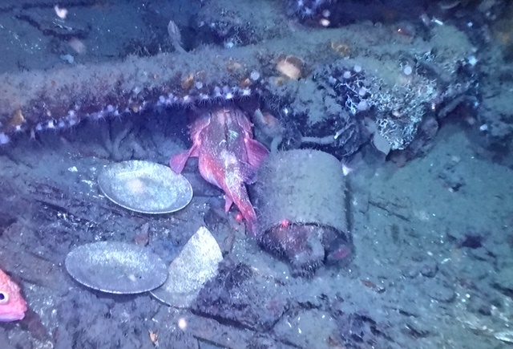
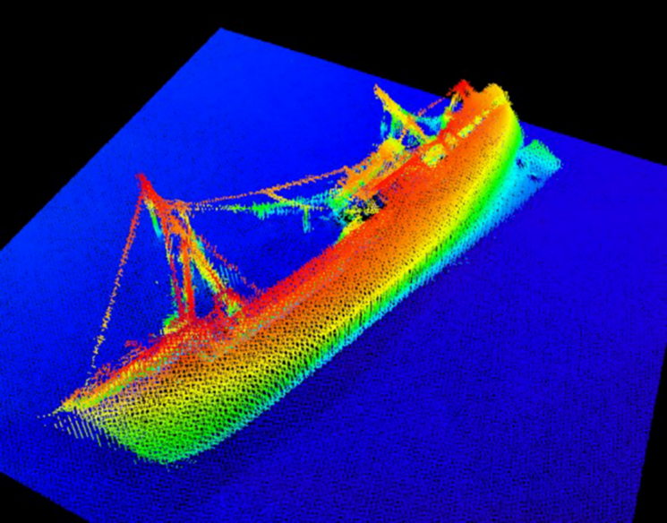
…examine a shipwreck

Slide 22
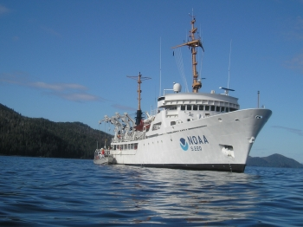
Hydrographic Survey Cruises
“Hydro” ships chart the ocean floor for safe navigation. Activities include echosounding, tide gauge installation, dive operations, shoreside surveying, shoreline verification and mapping, data processing, and drafting.
Small boat and survey launch work is conducted during daylight operations, whereas ship operations may occur during the day or night.
Hydrographic ships include Fairweather (pictured above), Ferdinand R. Hassler, Thomas Jefferson, and Rainier.

Slide 23
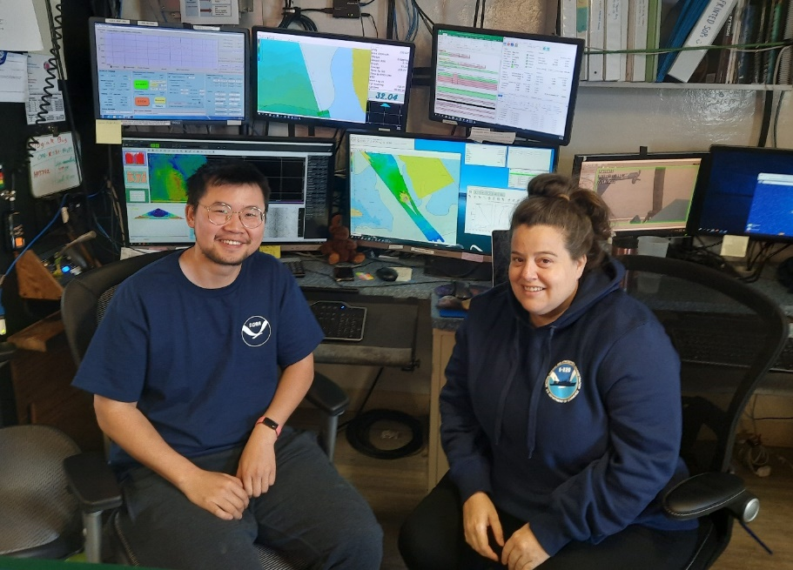
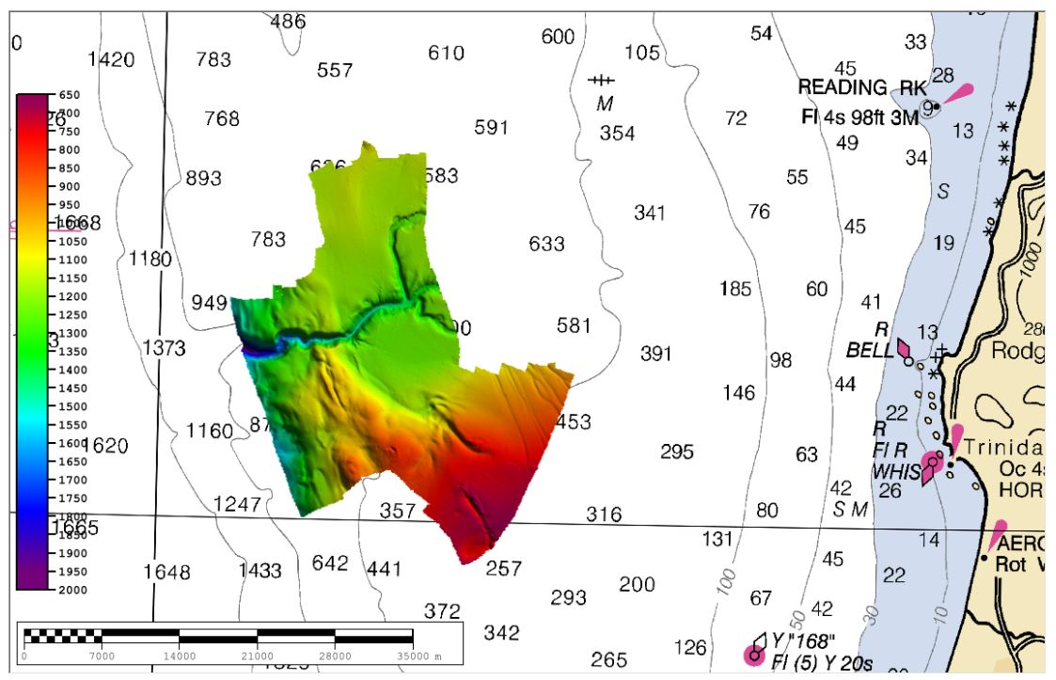
If you sail on a hydrographic cruise, you may…
…chart the ocean floor

Slide 24
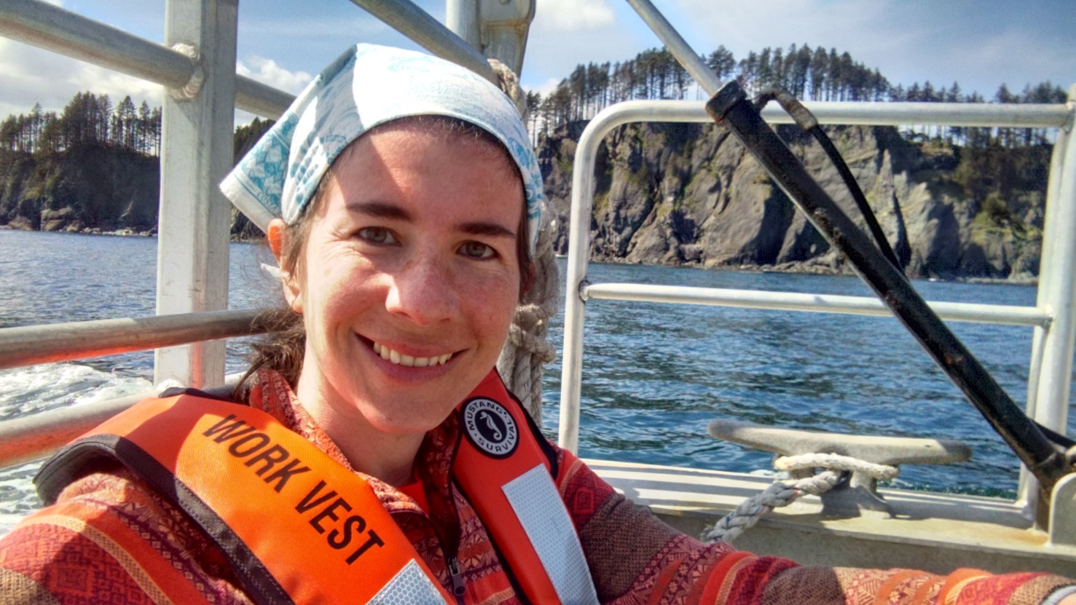
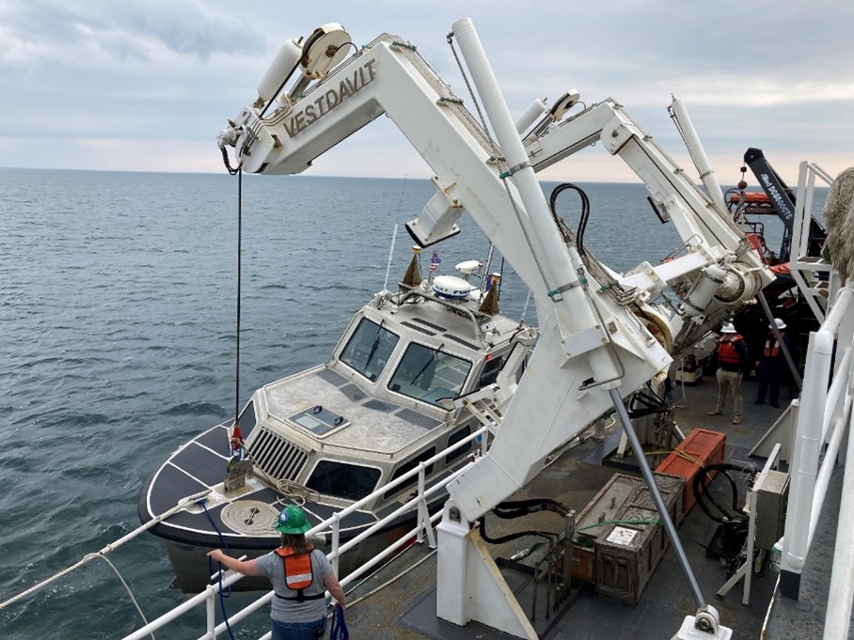
…survey shorelines from a launch

Slide 25
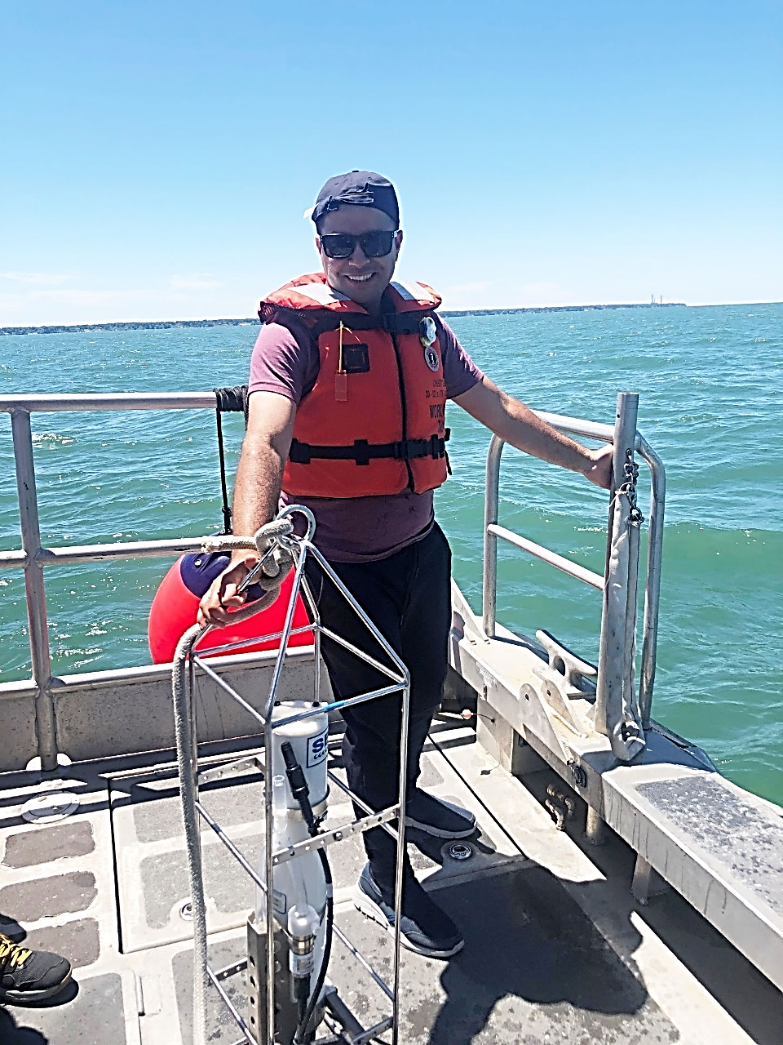
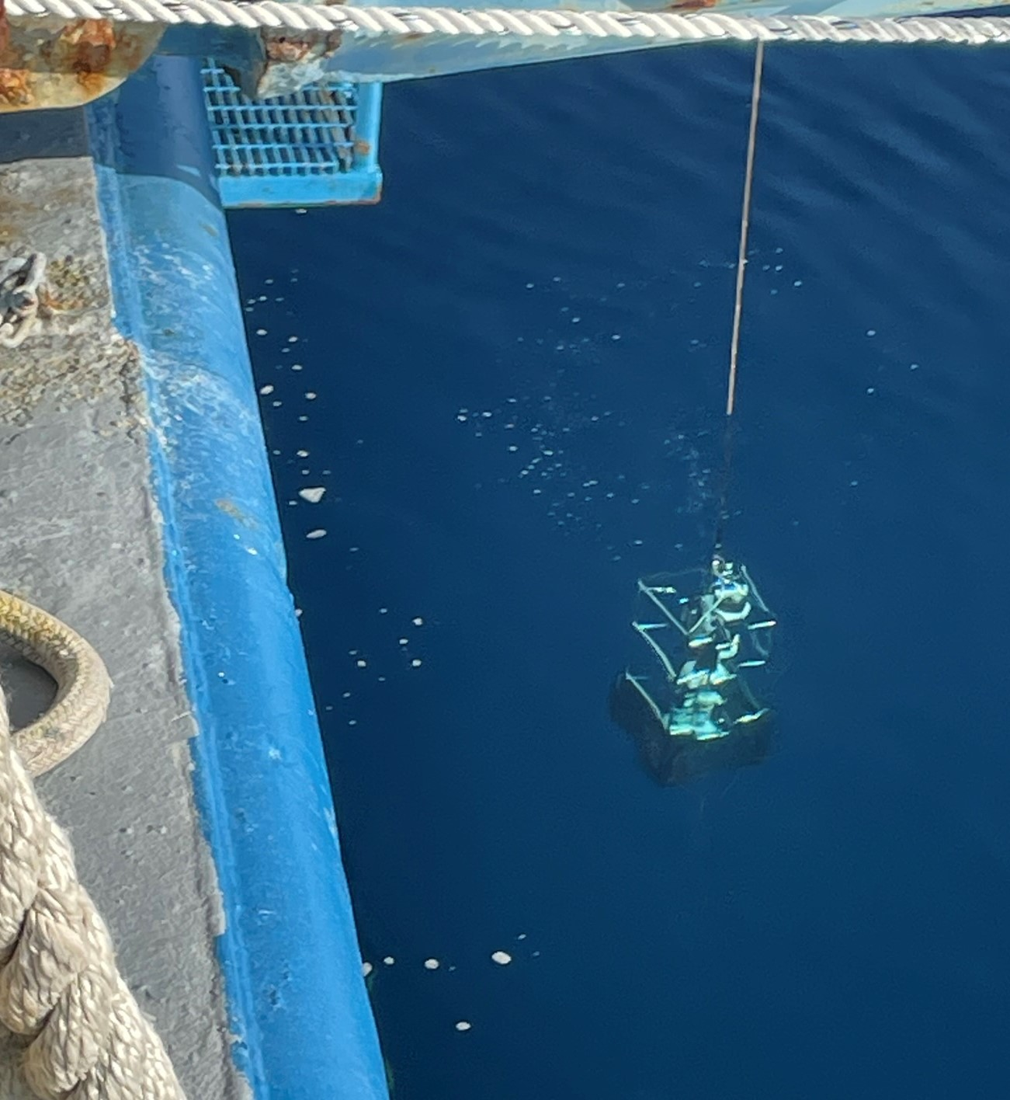
…deploy probes and sensors

Slide 26
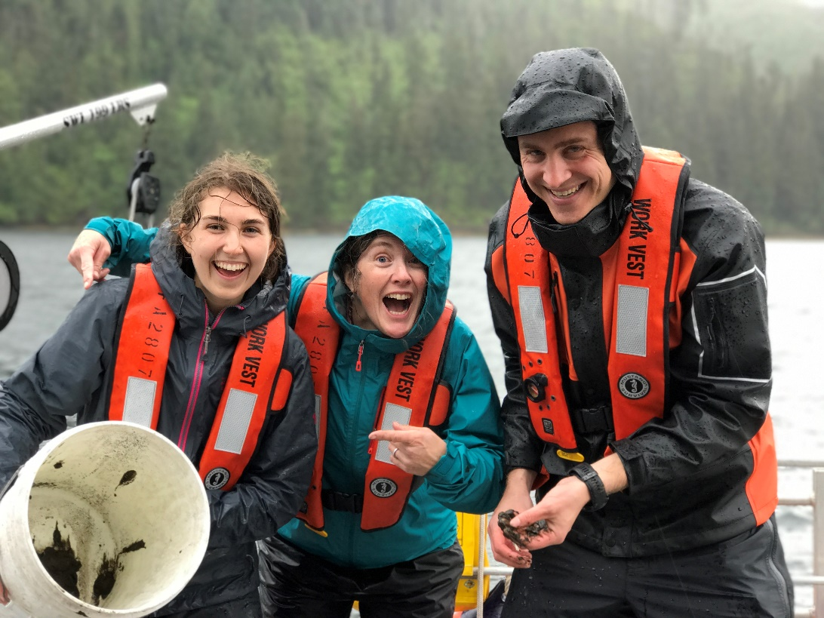
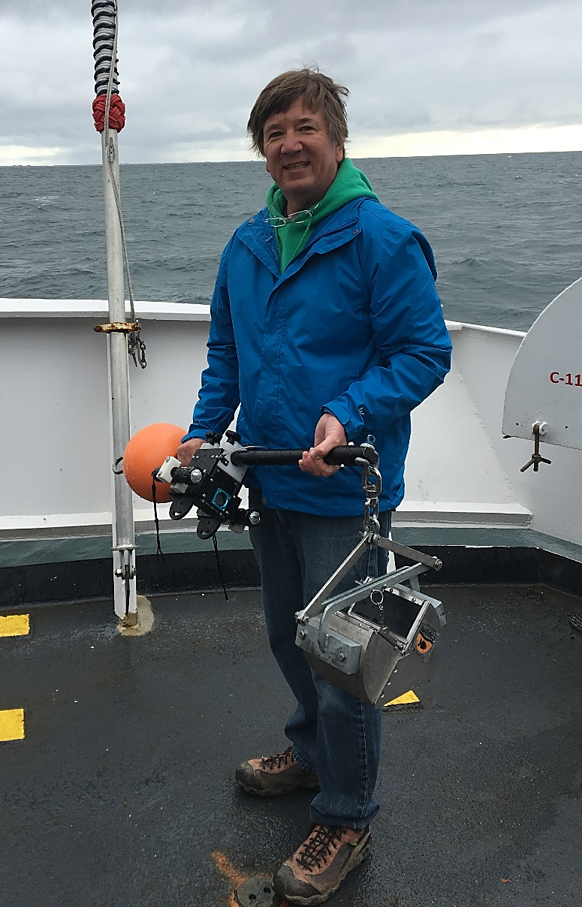
…collect a
seafloor sample

Slide 27
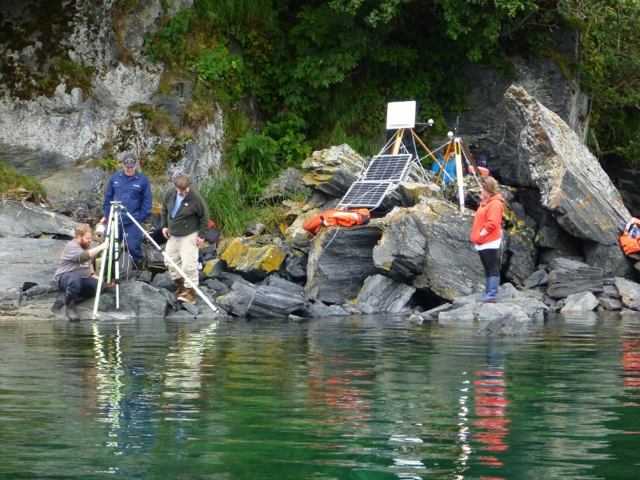
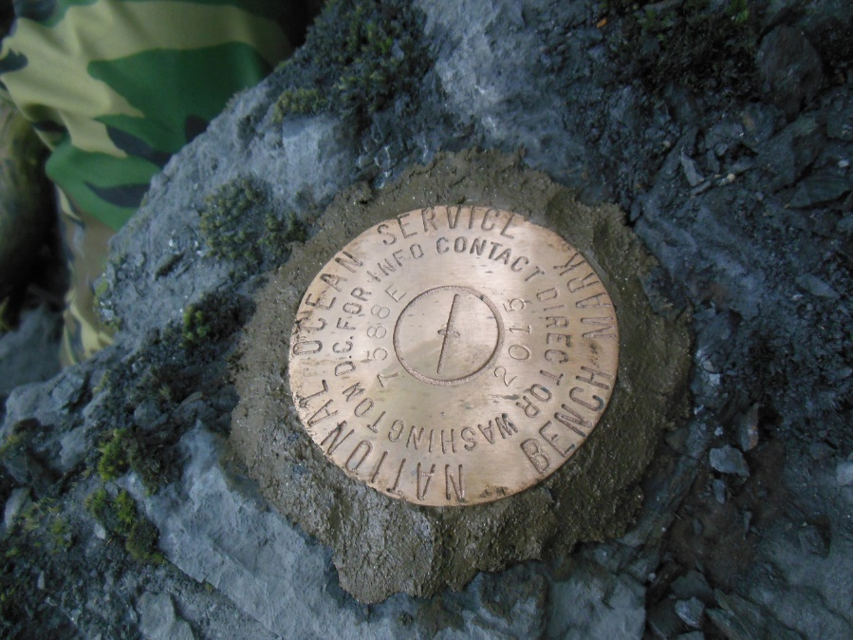
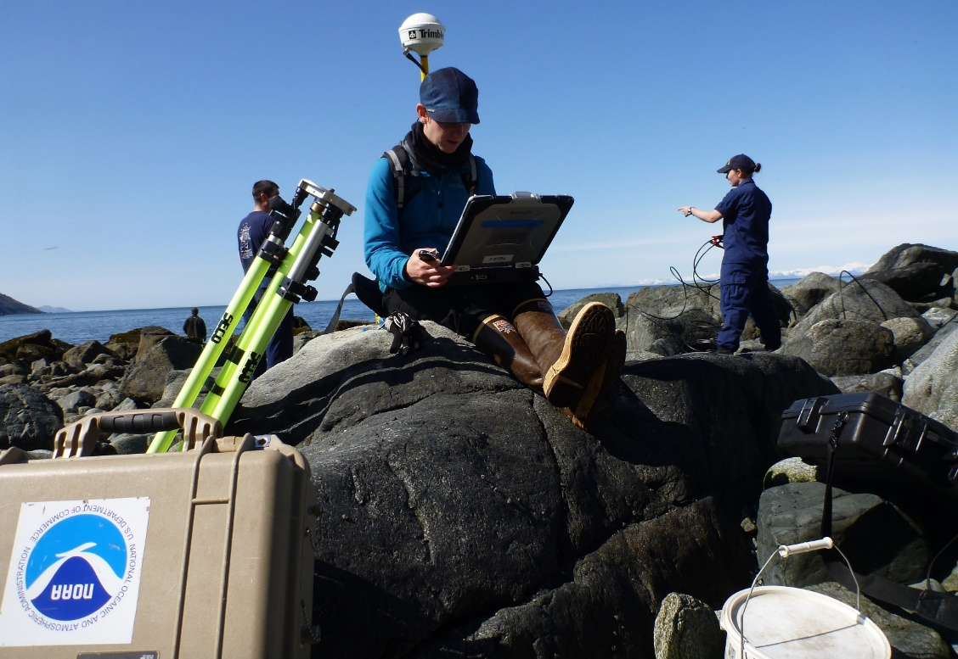
…install a tide gauge

Slide 28
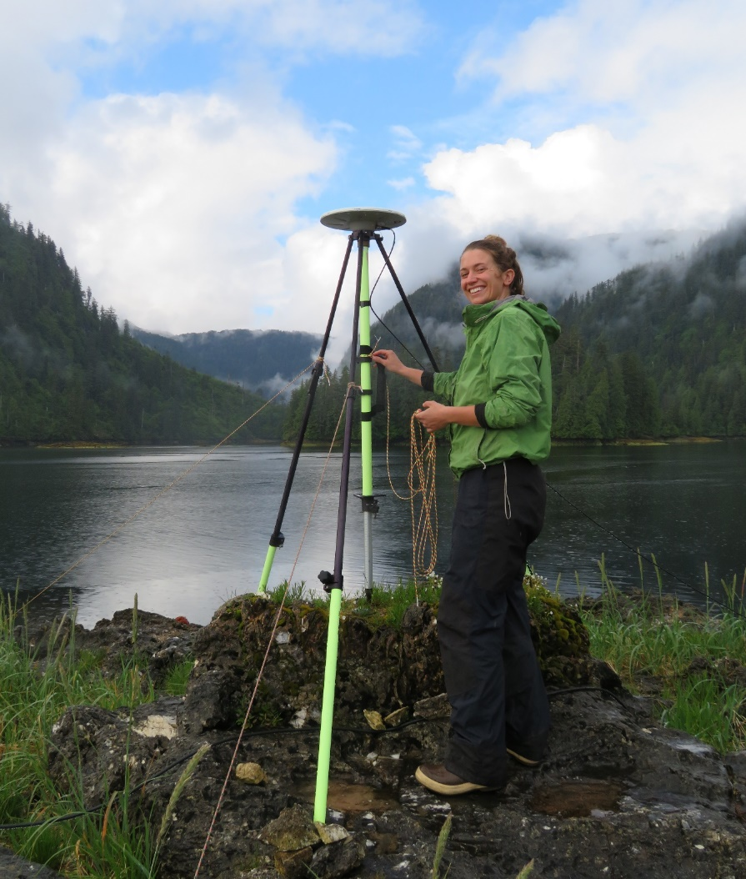
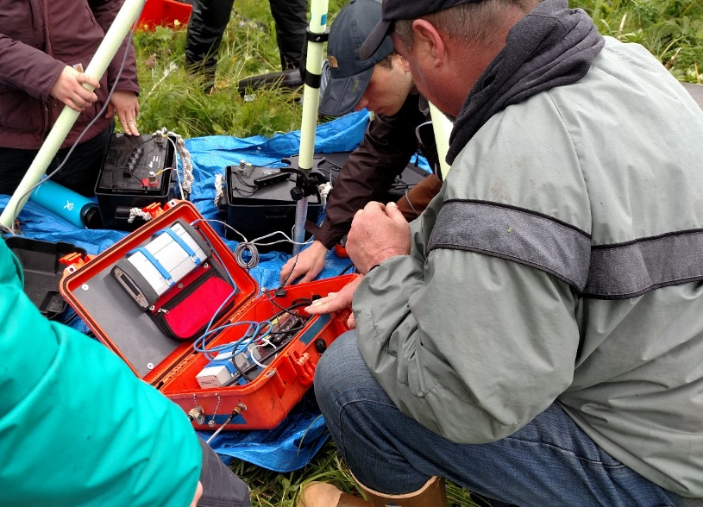
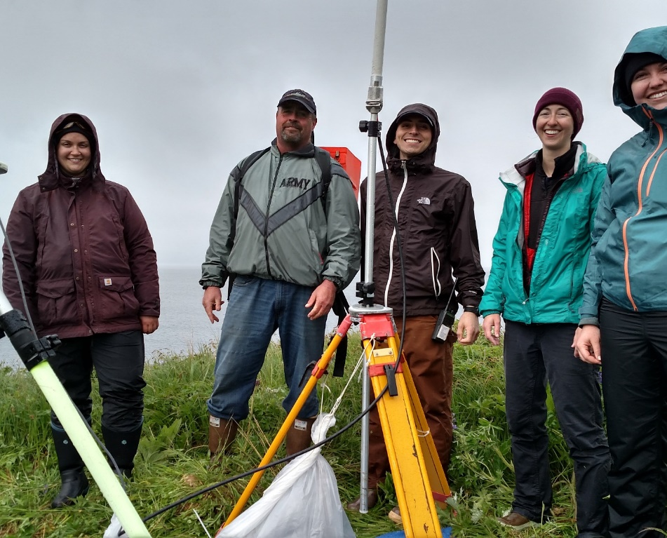
…set up a
base station

Slide 29
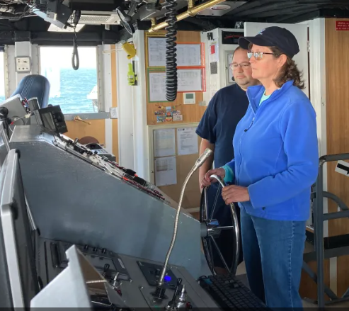
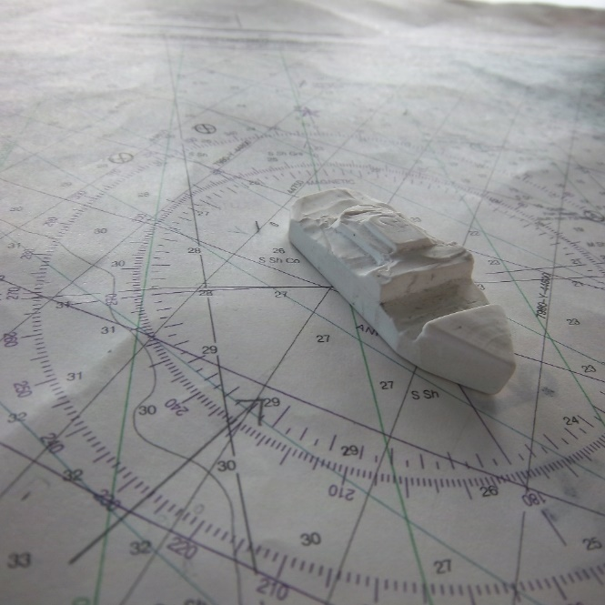
On any type of cruise, you may…
…help navigate the ship

Slide 30
…tour the engine room

Slide 31
…participate in safety drills

Slide 32
…observe feathered and finned friends

Slide 33
…meet the crew and learn about their careers

Slide 34
Program Videos
Why Send Teachers to Sea?
Facing your Fears
The Journey is Just the Beginning

Slide 35
The journey
is just the
beginning!
NOAA Teacher at Sea Alumni Association
Through the Teacher at Sea Alumni Association (TASAA), alumni enjoy a vibrant community of dedicated educators and continued opportunities for professional development.
Administered by the National Marine Sanctuary Foundation, TASAA helps participants who have completed their requirements build on their at-sea experience with additional connections to NOAA science and resources.

Slide 36
Contact info:
[insert your name]
[insert your email address]
Find out more on the web and follow the programs on social media
@noaateacheratsea
@teacheratseaalumni
teacheratsea.noaa.gov
noaateacheratsea.blog
teacheratseaalumni.org
@noaateacheratsea

